Slide 2

Walking Closer in Purity

Slide 3
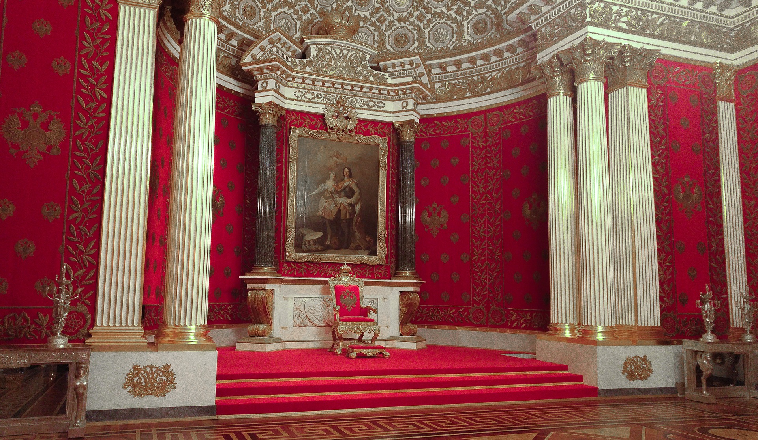

Slide 4
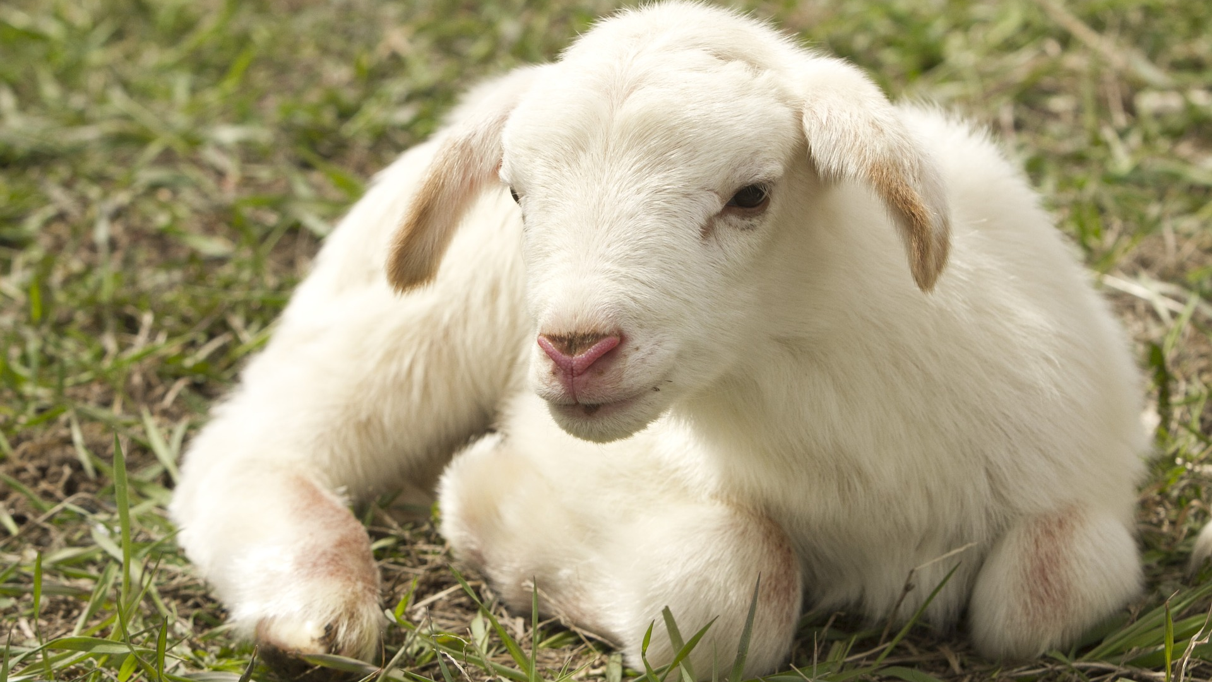

Slide 5


Slide 6


Slide 7


Slide 8


Slide 9


