Slide 1
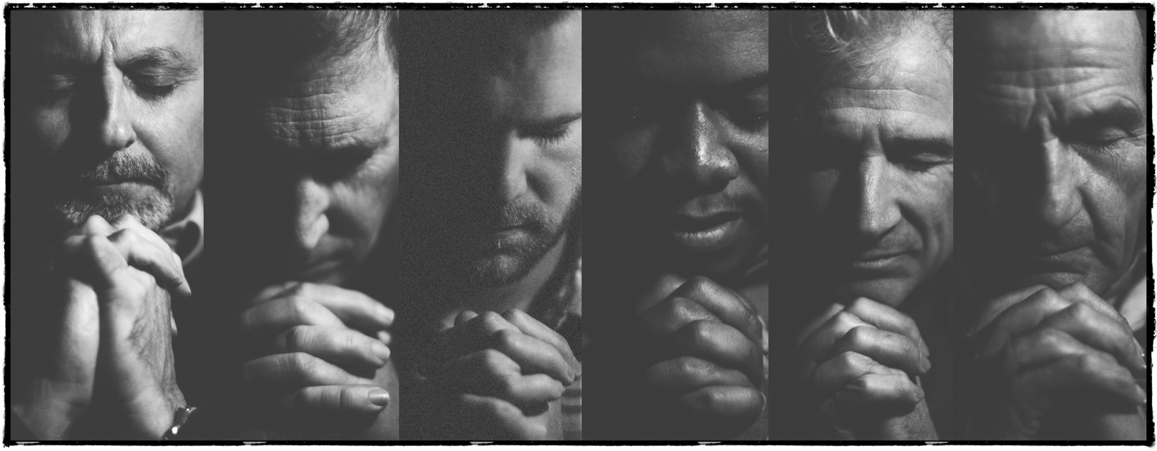
Training Prayers

Slide 2
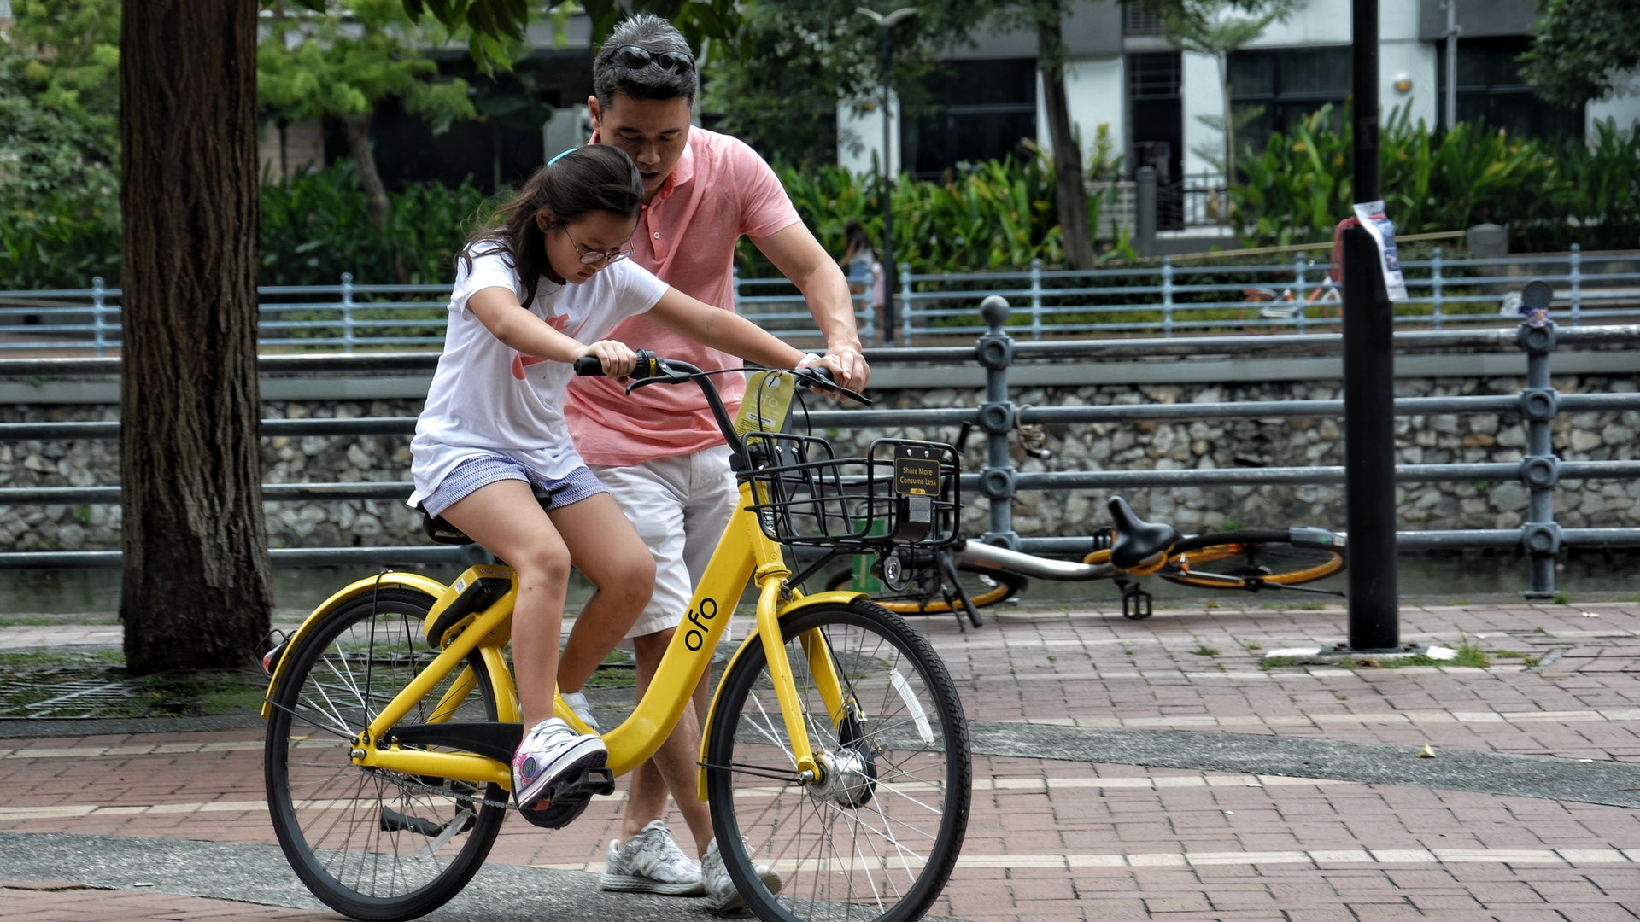

Slide 3
⁵ “When you pray, you are not to be like the hypocrites; for they love to stand and pray in the synagogues and on the street corners so that they may be seen by men. Truly I say to you, they have their reward in full.
- Matthew 6:5

Slide 4


Slide 5
⁷ “And when you are praying, do not use meaningless repetition as the Gentiles do, for they suppose that they will be heard for their many words.
- Matthew 6:7

Slide 6
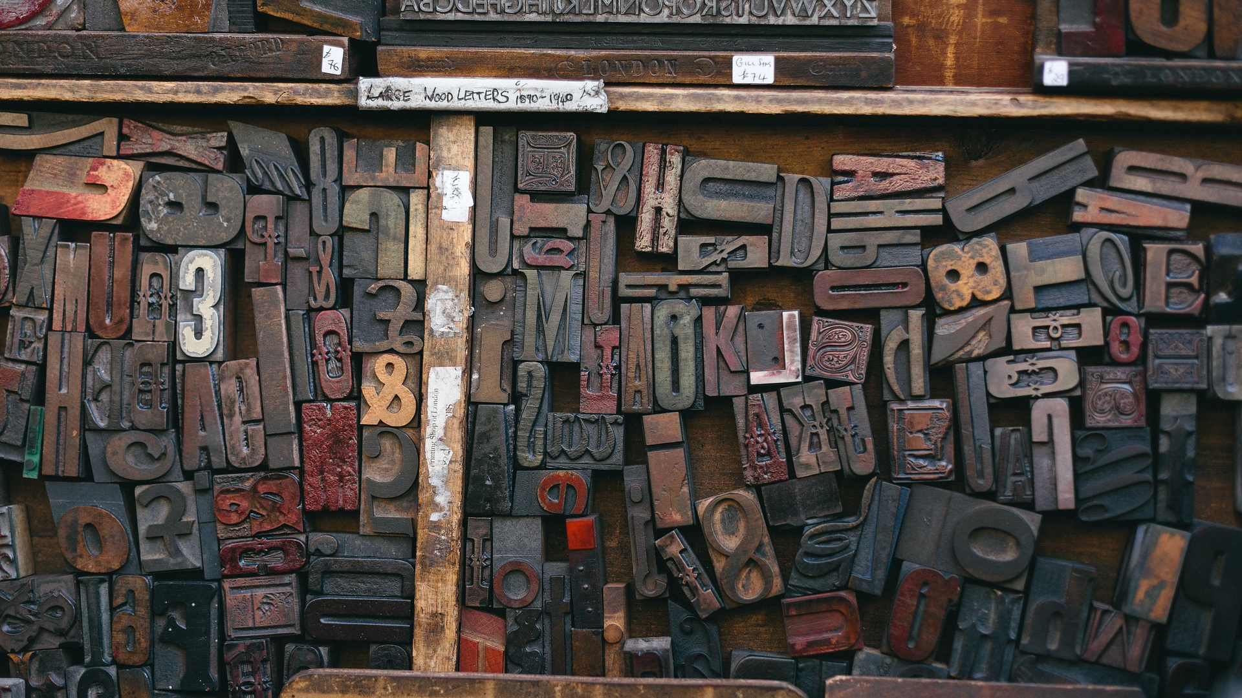

Slide 7
⁹ “Pray, then, in this way:
‘Our Father who is in heaven,
Hallowed be Your name.
- Matthew 6:9

Slide 8


Slide 9
¹⁰ ‘Your kingdom come.
Your will be done,
On earth as it is in heaven.
- Matthew 6:10

Slide 10
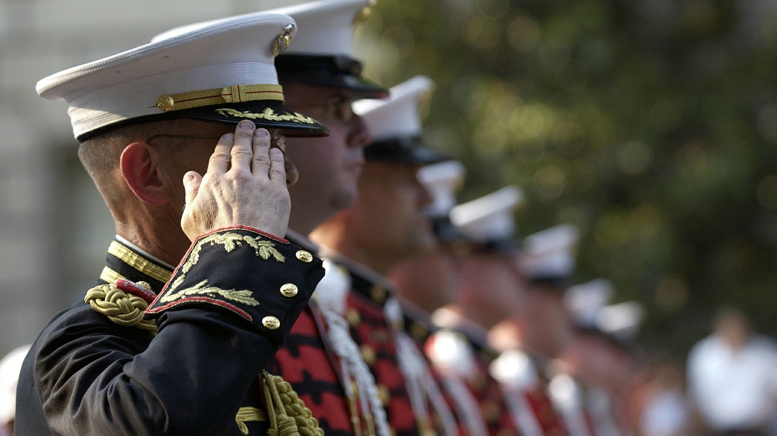

Slide 11
¹¹ ‘Give us this day our daily bread.
¹² ‘And forgive us our debts, as we also have forgiven our debtors.
¹³ ‘And do not lead us into temptation, but deliver us from evil.
For Yours is the kingdom and the power and the glory forever. Amen.’
- Matthew 6:11–13

Slide 12


Slide 13
