Slide 1
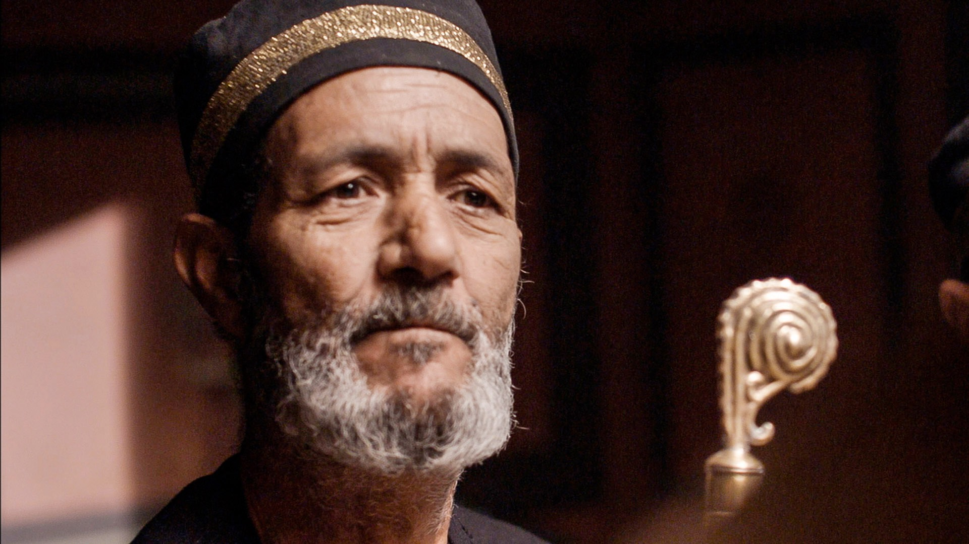
Powerless
Prayers

Slide 2
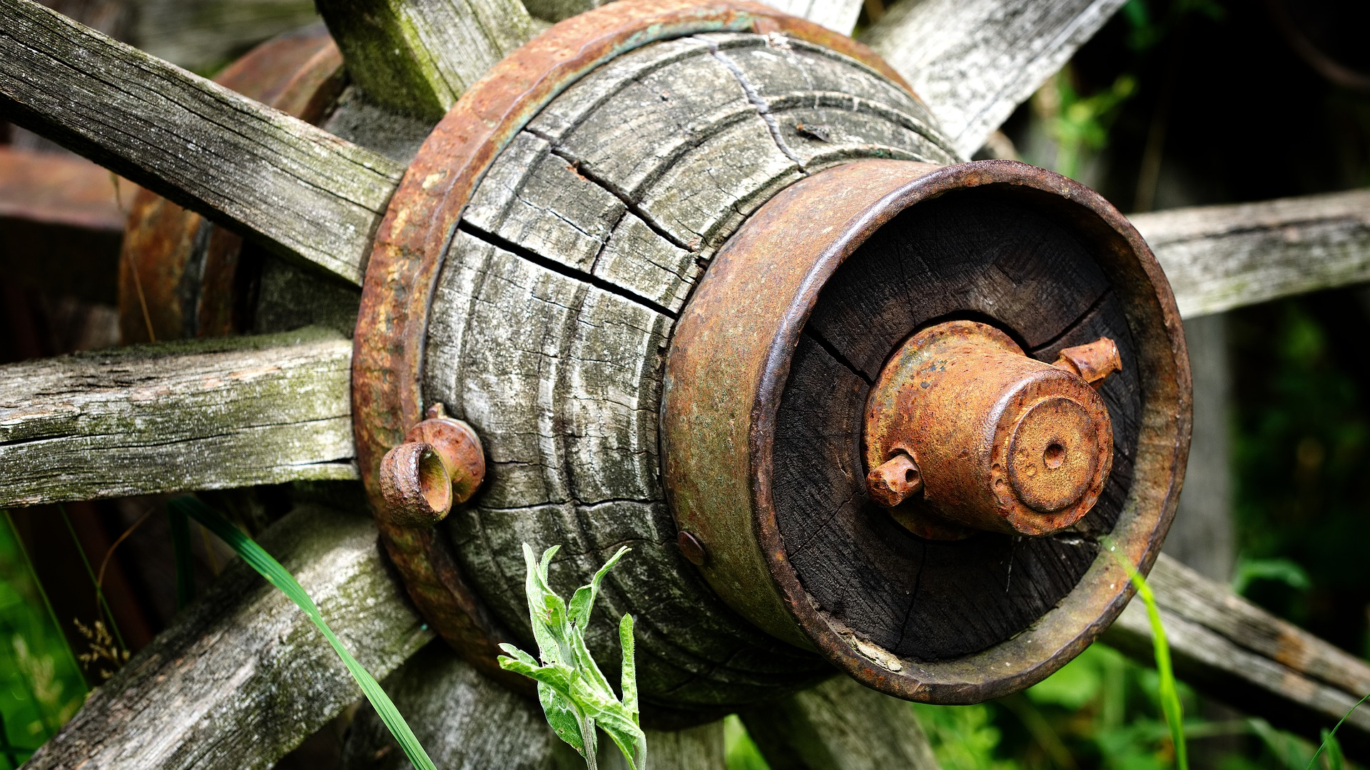

Slide 4
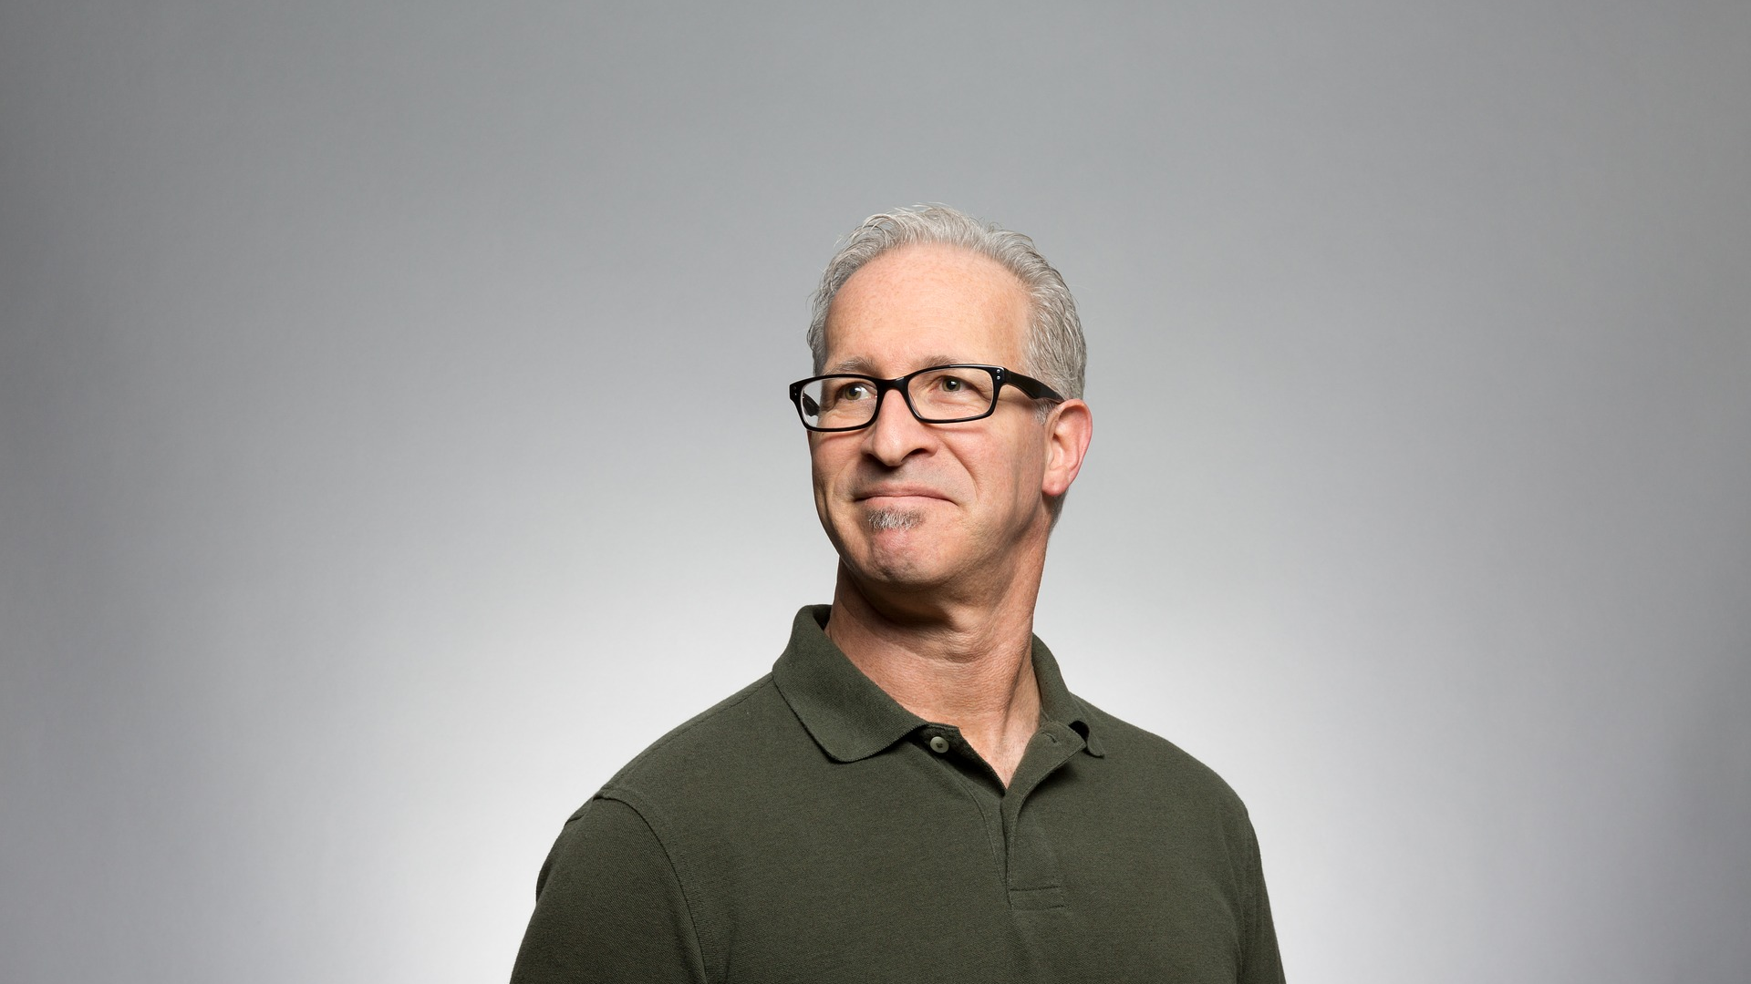

Slide 5
¹¹ “The Pharisee stood and was praying this to himself: ‘God, I thank You that I am not like other people: swindlers, unjust, adulterers, or even like this tax collector. ¹² I fast twice a week; I pay tithes of all that I get.’
- Luke 18:11–12

Slide 6
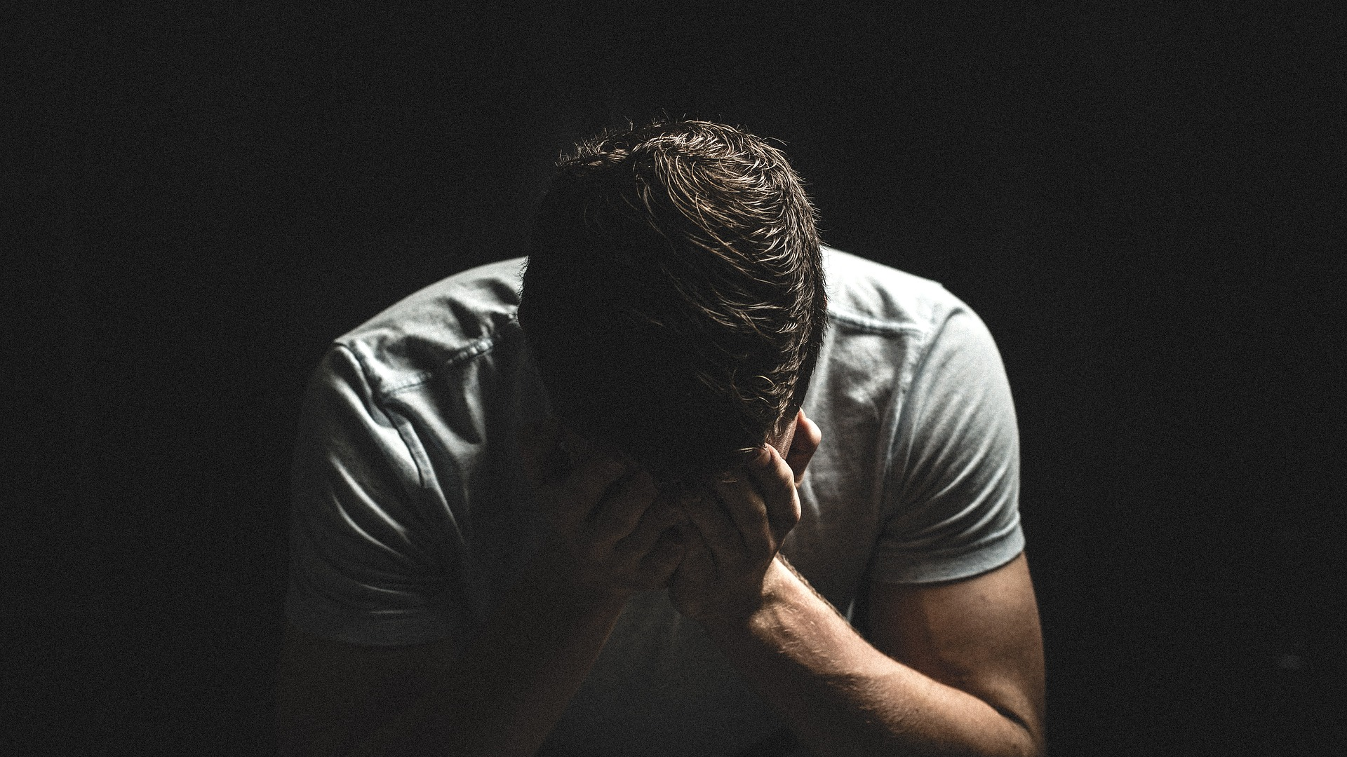

Slide 7
¹³ “But the tax collector, standing some distance away, was even unwilling to lift up his eyes to heaven, but was beating his breast, saying, ‘God, be merciful to me, the sinner!’
- Luke 18:13

Slide 8
Justified

Slide 9
