Slide 2
John 6:68-69

Slide 3
Why where they committed?
They Believed In Christ
They knew & were taught of Christ
They knew Christ was the giver of Eternal Life

Slide 4
My Commitment in 2016
What is your commitment going to look like?

Slide 5
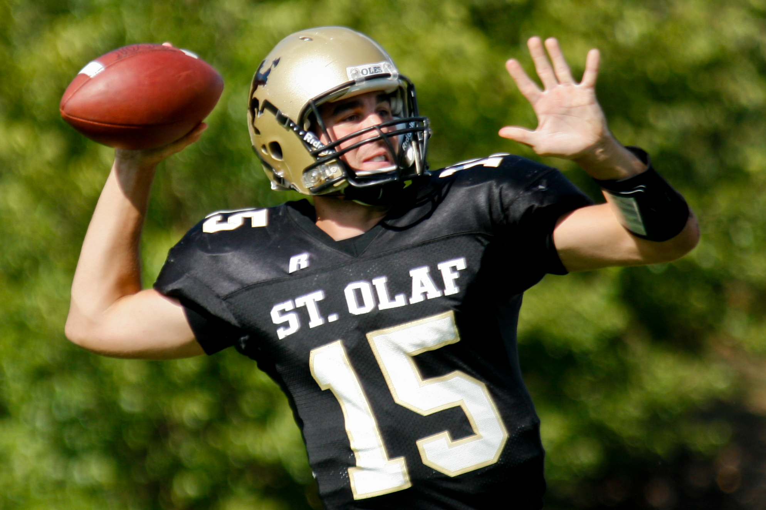
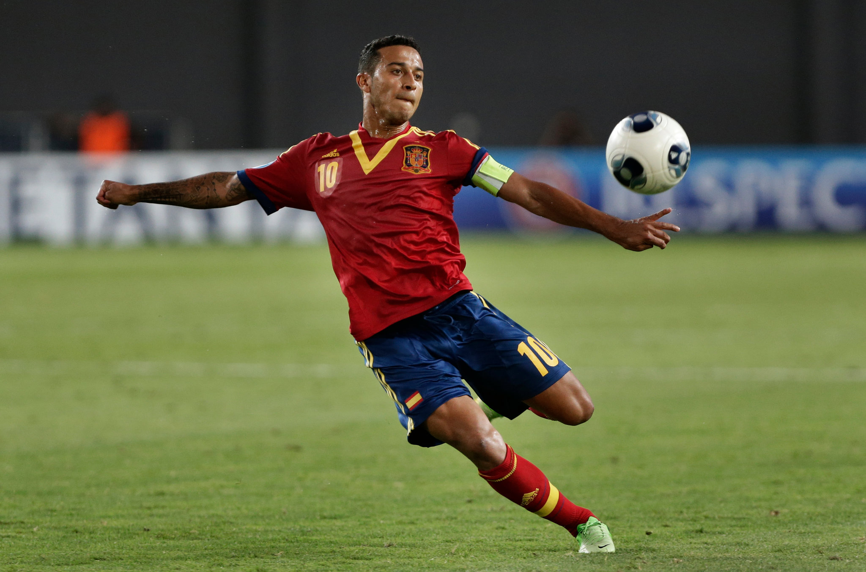
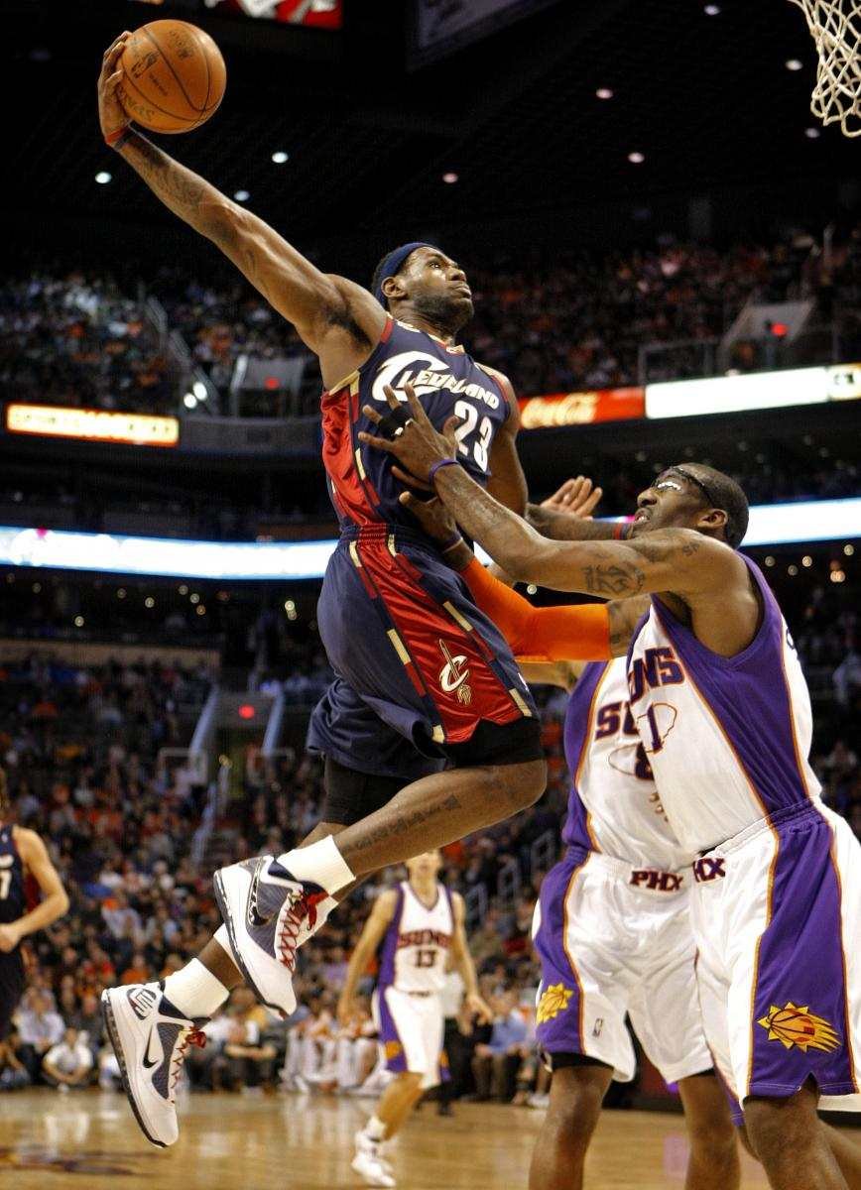
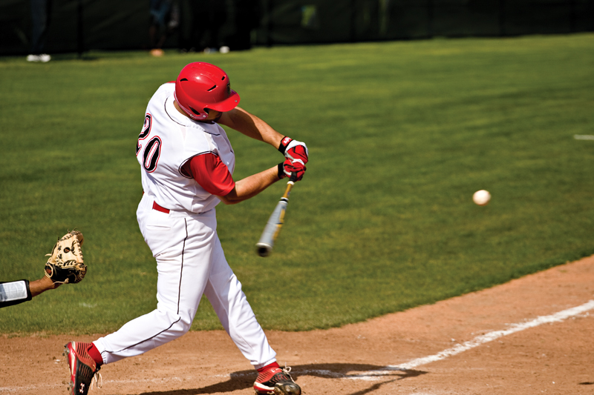
sports

Slide 6
When you join a team…
You try out…
You make the team with excitement.
You look forward to the challenges
You look forward to the comradery
You look forward to your families & friends cheering you on.

Slide 7
Training/conditioning
During the week you workout
You go to practices to learn the game & practice plays
You eat the right foods

Slide 8
Playing the game
You complete the plays
You feed off of your teammates
You listen to your coach for direction
You leave everything you have on that field

Slide 9
Putting everything together…
Joining the team
Training & Conditioning
Playing the game
All of these sports ask of you to be COMMITTED!!!

Slide 10
We Understand this concept in…
Sports
School
Work
Things We Enjoy
But why do some seem to miss place the word commitment when it comes to God and His Church???

Slide 11
Uncommitted
Never made the right commitment (John 6)
When trust has been lost (Psalm 34:8)
When it gets “too hard” to continue
When the honeymoon period has passed

Slide 12
Being uncommitted doesn’t happen overnight… It usually happens in a drifting series of events…

Slide 13
What are the signs?
Lack of spiritual feeding…
Lack of communication to God…
Lack of godly living…
Lack of godly characteristics…

Slide 14
What is the solution?
Feed your spiritual man!
Communicate with God in prayer!
Attend the gathering of the Saints!
Work on your godly character & living!

