Slide 1

Mindful Meditation

Slide 2


Slide 4

Psalm 1:2

Slide 5


Slide 6
Psalm 119:15
Psalm 119:48
Psalm 119:78
Psalm 119:148

Slide 7

Philippians 4:8

Slide 8
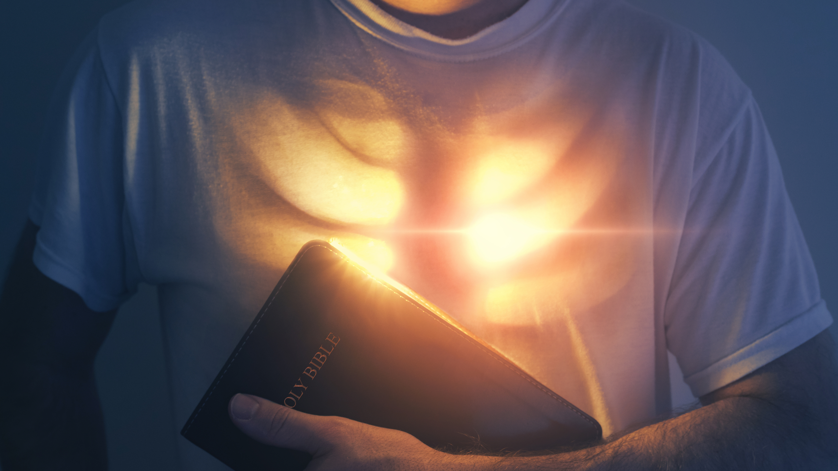
1 Timothy 4:15-16

