Slide 1

  The key to the future

Slide 2
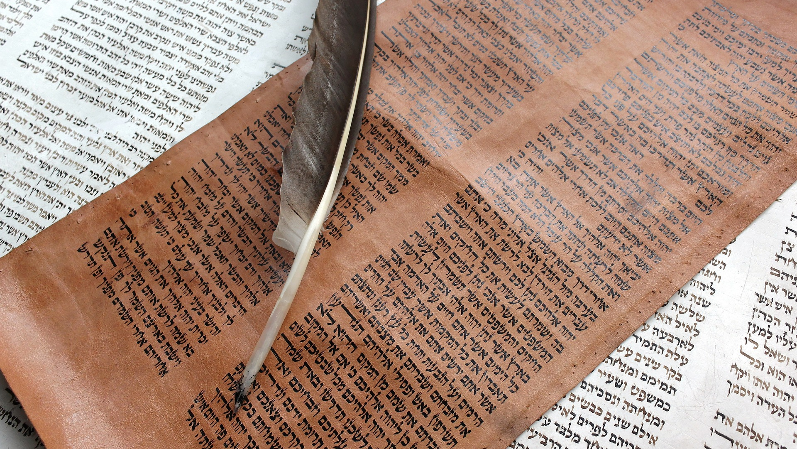

Slide 3
1 Kings 19

Slide 4

Jeremiah 36, 38:6

Slide 5

Genesis 15:1-8
Joshua 21:43-45

Slide 6

Exodus 3
Jonah 4:2
Joel 2:13

Slide 7

Isaiah 61:1-3
Luke 4:14-30
Jeremiah 31:31-34

Slide 8


