Slide 1
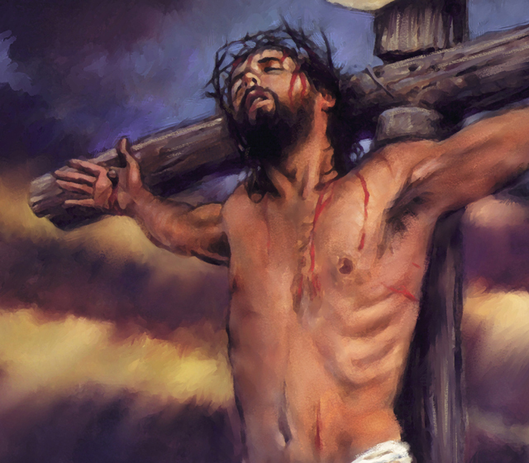
THE IRONY OF
THE CROSS

Slide 2
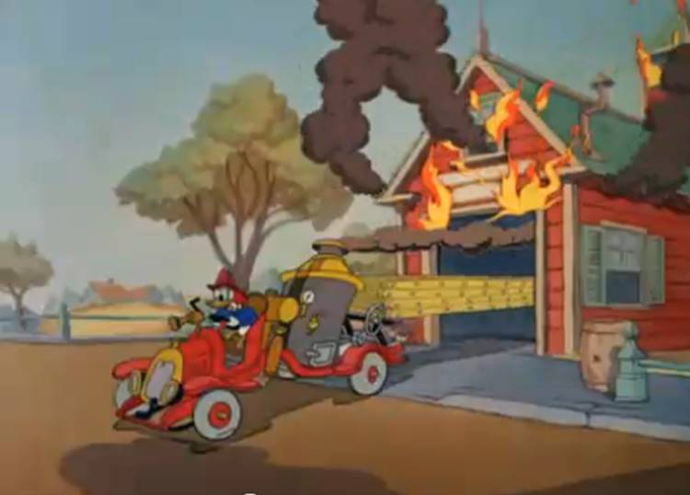
“Ironic” means “opposite of what you would expect” or “self-contradictory”
1. Fire house burns down
2. Attorney General convicted
of crimes
3. America, founded for religious reasons, now
ridicules those principles
4. America, with greatest standard of living also
has the most divorces, suicides, mental breakdowns.

Slide 3
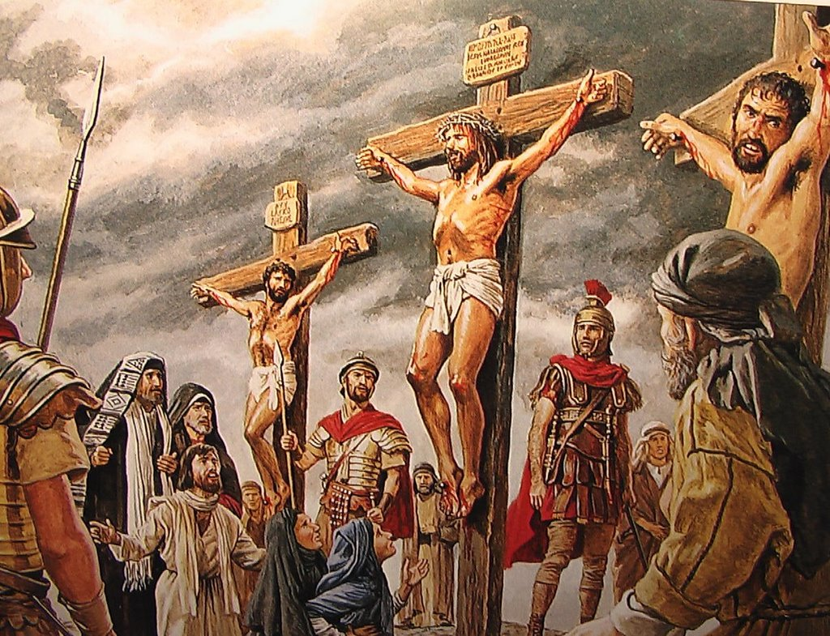
I. THE CROSS—(A SYMBOL
OF SHAME, CRIME AND
DEGRADATION) BECAME
THE SYMBOL OF HOPE,
PURITY AND GLORY.
1. Several ways to execute someone (some with dignity)
but crucifixion was for slaves and low criminals.
2. Jesus endured the curse of the cross (Gal 3:13)
3. Jesus endured the shame of the cross (Heb 12:2)
4. Ironically—it became the very means of his victory and exaltation. (Phil 2:8-11)

Slide 5
I. THE CROSS: IRONICALLY WHAT IT SEEMED
TO BE--WAS NOT WHAT IT WAS AT ALL
1. Roman Soldiers—just another routine day
2. Disciples—crushing, humiliating defeat
3. Chief Priests—sweet victory over one who dared
challenge their authority
4. Bystanders—interesting, sadistic entertainment

Slide 6
4. To God—The great moment planned since the beginning of the world, the holy altar of perfect sacrifice for sin.
A. “God was in Christ, reconciling the world to Himself.”
(II Cor 5:19)
B. “This was in accordance with the eternal purpose which He carried out in Christ Jesus our Lord.”
(Eph 3:11)
C. God was bringing about the focal point of all He had done to redeem man back to Himself.

Slide 7
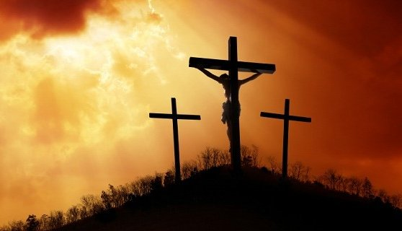
5. To Jesus—It was the culmination of all He had come to do:
A. Culmination of His eternal plan and preparation
B. Culmination of 33 years of sinless living as a man
C. “For this purpose I came to this hour.” John 12:27

Slide 8
6. So, while the:
A. Roman Soldiers gambled at the foot of the cross
B. Disciples stared in terror and confusion from a distance
C. Priests gloated and ridiculed
D. Mob gaped, mocked, and enjoyed he entertainment
E. THE GREATEST EVENT IN THE HISTORY OF THIS PLANET WAS TAKING PLACE BEFORE THEIR EYES!
1) Jesus was bearing he sins of the world
(II Cor 5:21)
2) Men were being reconciled to God
(Col 1:19-22)

Slide 9
II. THE MOST TRAGIC IRONY OF IRONIES: THOUGH THE BENEFITS OF THE CROSS ARE AVAILABLE TO ALL—IT IS REJECTED BY SOME.
A. “Whosoever will” may come
B. “Repent and be baptized every one of you…”
C. I Cor 1:18, 23-24
D. We have only two choices:
1. Receive its benefits and blessings
2. Dismiss it as foolishness and be forever lost

