Slide 2
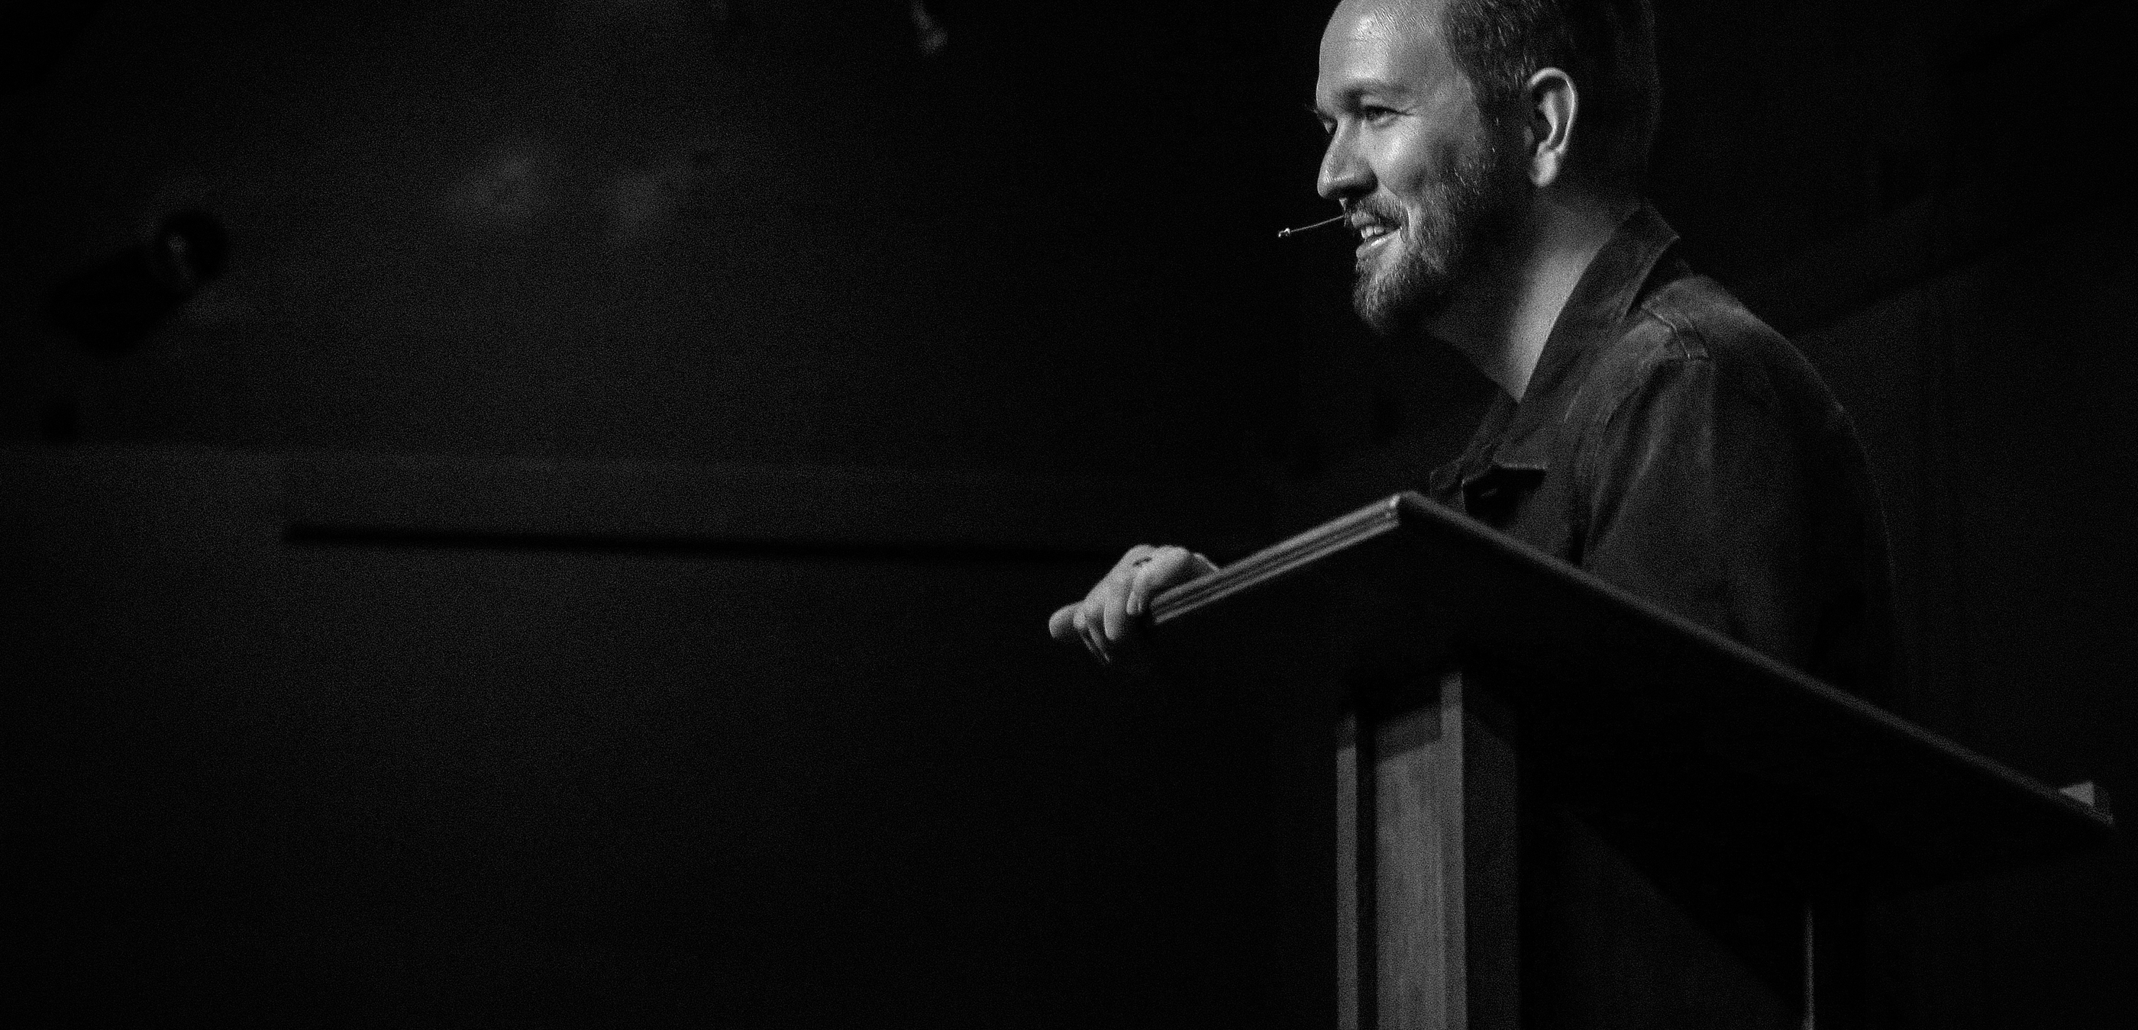
How Does the Preacher Work?

Slide 3
Elder
Shepherd
Overseer

Slide 4
The elders who rule well are to be considered worthy of double honor, especially those who work hard at preaching and teaching.
- 1 Timothy 5:17

Slide 5


Slide 6
¹ I solemnly charge you in the presence of God and of Christ Jesus, who is to judge the living and the dead, and by His appearing and His kingdom: ² preach the word; be ready in season and out of season; reprove, rebuke, exhort, with great patience and instruction.
- 2 Timothy 4:1–2

Slide 7
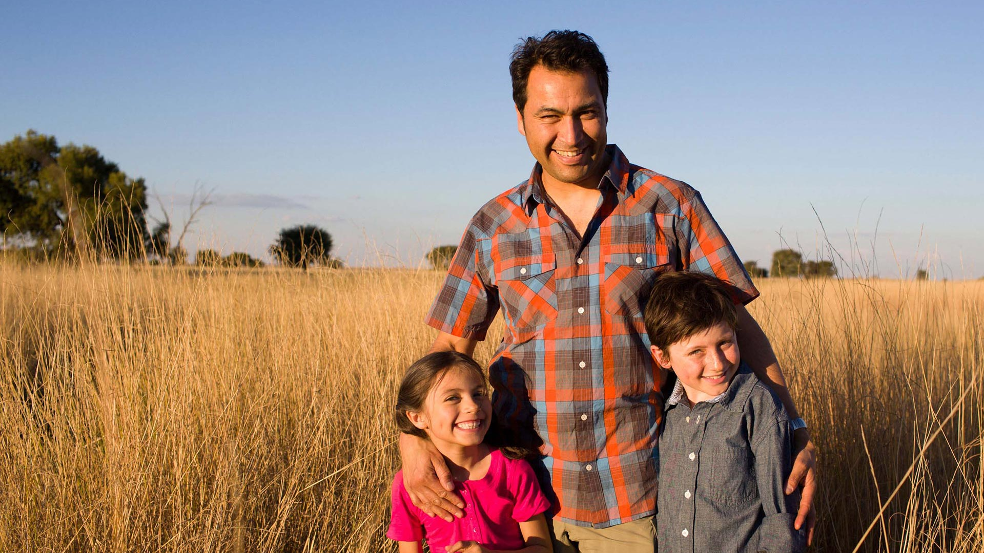

Slide 8



Slide 9
Be diligent to present yourself approved to God as a workman who does not need to be ashamed, accurately handling the word of truth.
- 2 Timothy 2:15

Slide 10
²⁶ “Therefore, I testify to you this day that I am innocent of the blood of all men. ²⁷ “For I did not shrink from declaring to you the whole purpose of God.
- Acts 20:26–27

Slide 11


Slide 12
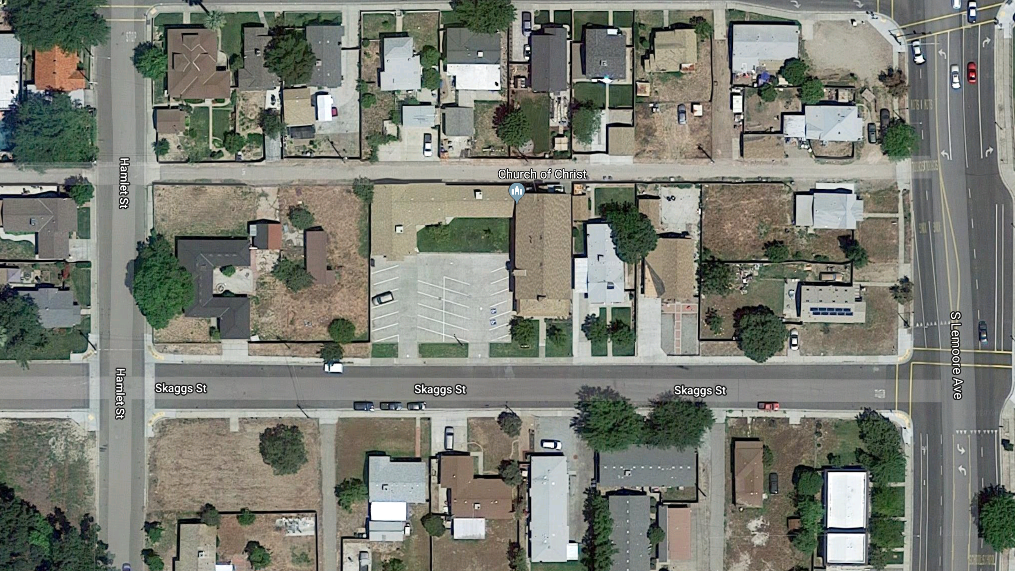
Copyright Google Maps 2017

Slide 13
As I urged you upon my departure for Macedonia, remain on at Ephesus so that you may instruct certain men not to teach strange doctrines,
- 1 Timothy 1:3
This took place for two years, so that all who lived in Asia heard the word of the Lord, both Jews and Greeks.
- Acts 19:10

Slide 14
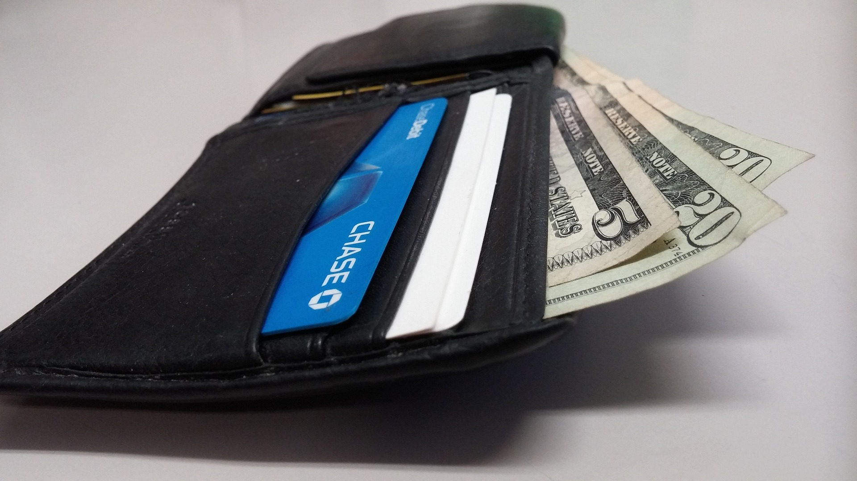

Slide 15
¹³ Do you not know that those who perform sacred services eat the food of the temple, and those who attend regularly to the altar have their share from the altar? ¹⁴ So also the Lord directed those who proclaim the gospel to get their living from the gospel.
- 1 Corinthians 9:13–14

Slide 16


Slide 17


