Slide 1
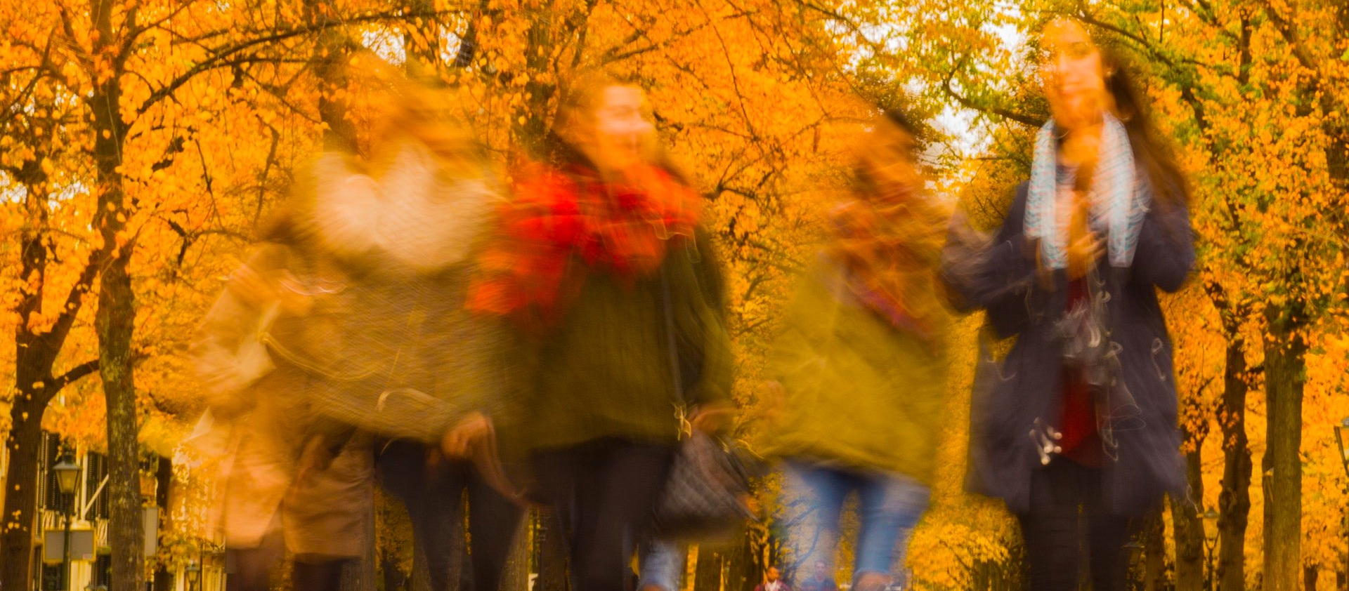
How Does Friendship Work?

Slide 2

A Different Kind of Love
Kindly affectionate, a love that is born and grown from a relationship
Brotherly love, friends

Slide 3

John 16:26-27

Slide 4
Matthew 10:37

Slide 5

Titus 2:4

Slide 6
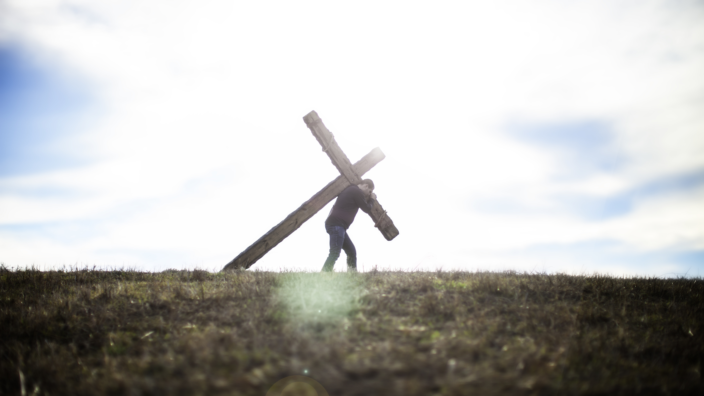
John 15:13-14

Slide 7
Romans 12:10

Slide 8
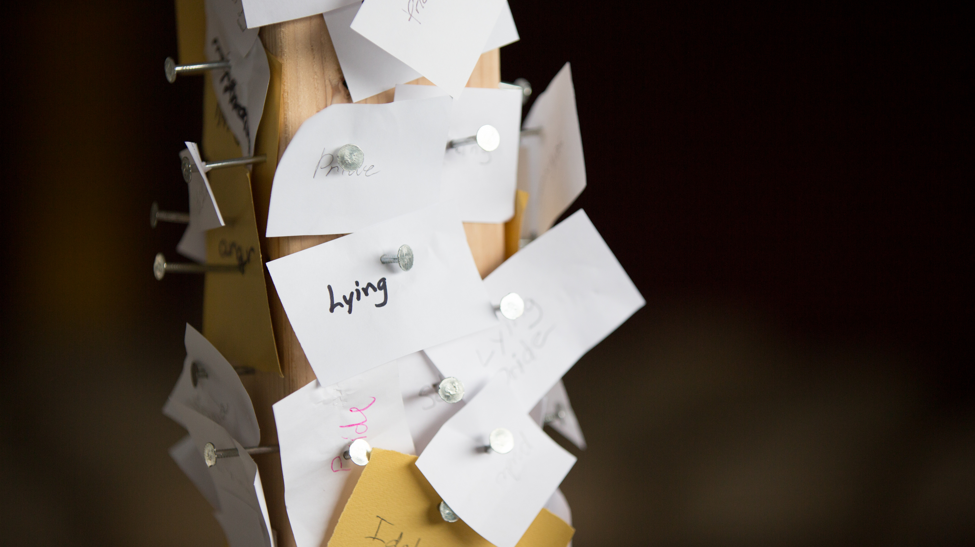
James 4:4

Slide 9
