Slide 1

The Glory of the Gospel

Slide 2


Slide 3


Slide 4


Slide 5


Slide 6
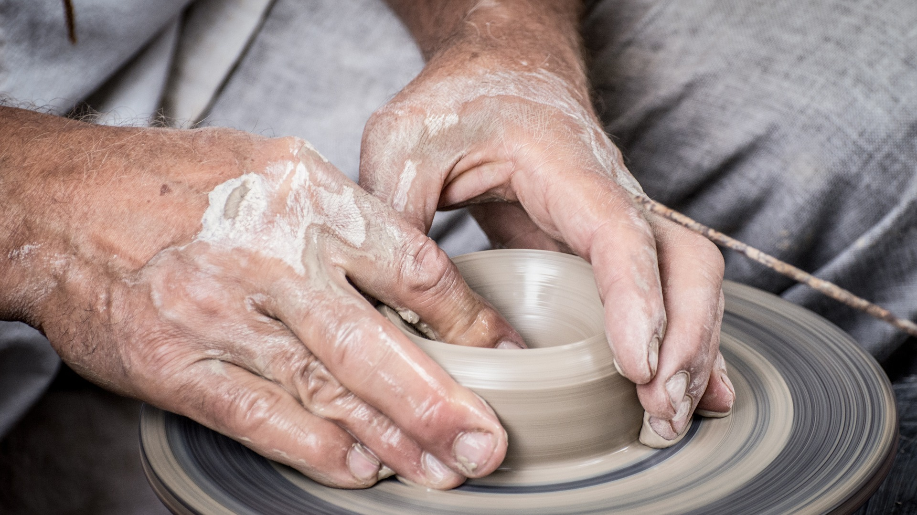

Slide 7


Slide 8
