Slide 1
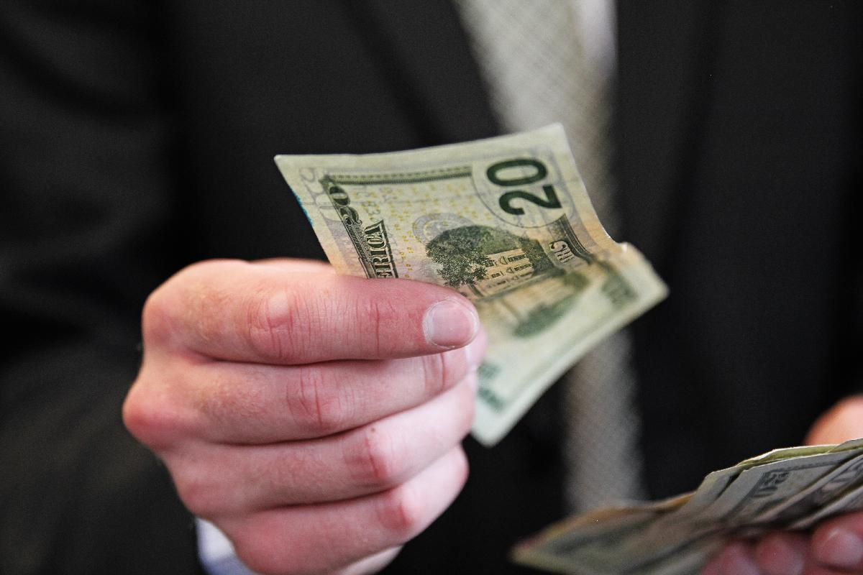
Gifts to God

Slide 2
Now this I say, he who sows sparingly will also reap sparingly, and he who sows bountifully will also reap bountifully.
2 Corinthians 9:6

Slide 4
Each one must do just as he has purposed in his heart, not grudgingly or under compulsion, for God loves a cheerful giver.
2 Corinthians 9:7

Slide 6
And God is able to make all grace abound to you, so that always having all sufficiency in everything, you may have an abundance for every good deed
2 Corinthians 9:8

Slide 8
For the ministry of this service is not only fully supplying the needs of the saints, but is also overflowing through many thanksgivings to God.
2 Corinthians 9:12

Slide 9
Because of the proof given by this ministry, they will glorify God for your obedience to your confession of the gospel of Christ and for the liberality of your contribution to them and to all,
2 Corinthians 9:13

Slide 11
Bountifully
Gratefully
Sacrificially

