Slide 1
Framework of Faith

Slide 2
Ash Carter [CC BY 2.0 (https://creativecommons.org/licenses/by/2.0)]

Slide 3


Slide 4


Slide 5
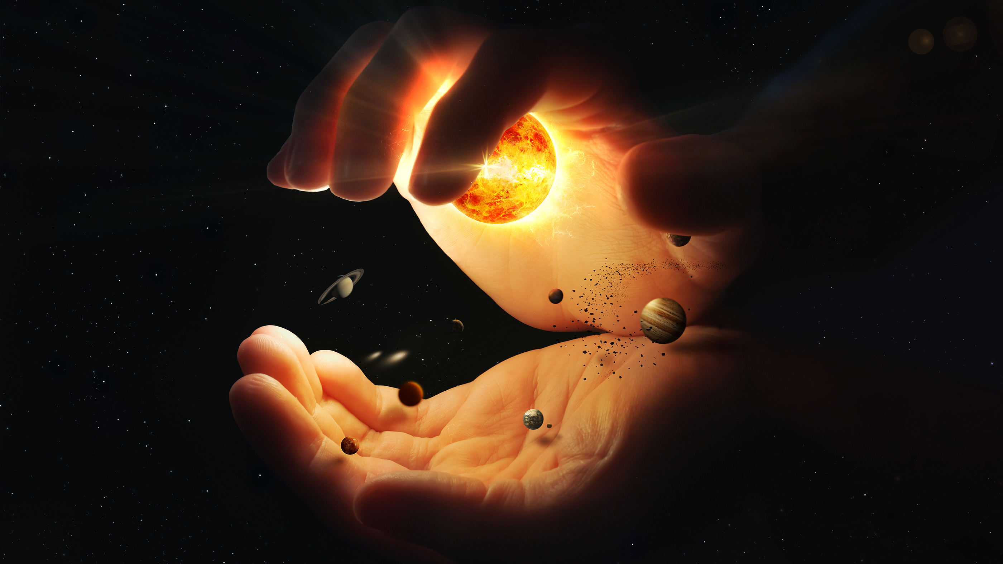

Slide 6


Slide 7



Slide 8


