Slide 1
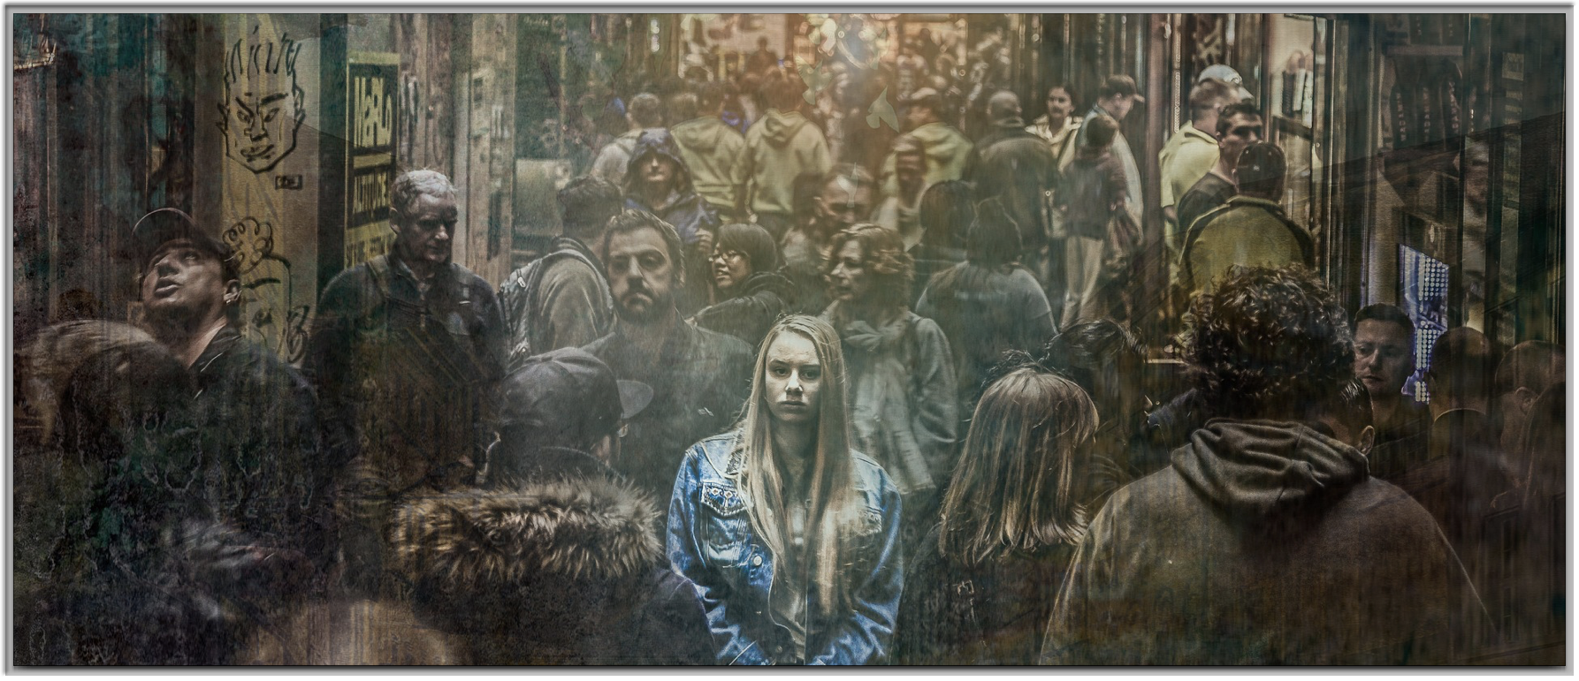
Encouragement Through Prayer

Slide 2


Slide 3
¹ Now He was telling them a parable to show that at all times they ought to pray and not to lose heart,
- Luke 18:1

Slide 4


Slide 5
⁴ “For a while he was unwilling; but afterward he said to himself, ‘Even though I do not fear God nor respect man, ⁵ yet because this widow bothers me, I will give her legal protection, otherwise by continually coming she will wear me out.’ ”
- Luke 18:4–5

Slide 6


Slide 7
⁶ And the Lord said, “Hear what the unrighteous judge said; ⁷ now, will not God bring about justice for His elect who cry to Him day and night, and will He delay long over them?
- Luke 18:6–7

Slide 8


Slide 9
⁸ “I tell you that He will bring about justice for them quickly. However, when the Son of Man comes, will He find faith on the earth?”
- Luke 18:8

Slide 10


Slide 11


