Slide 1
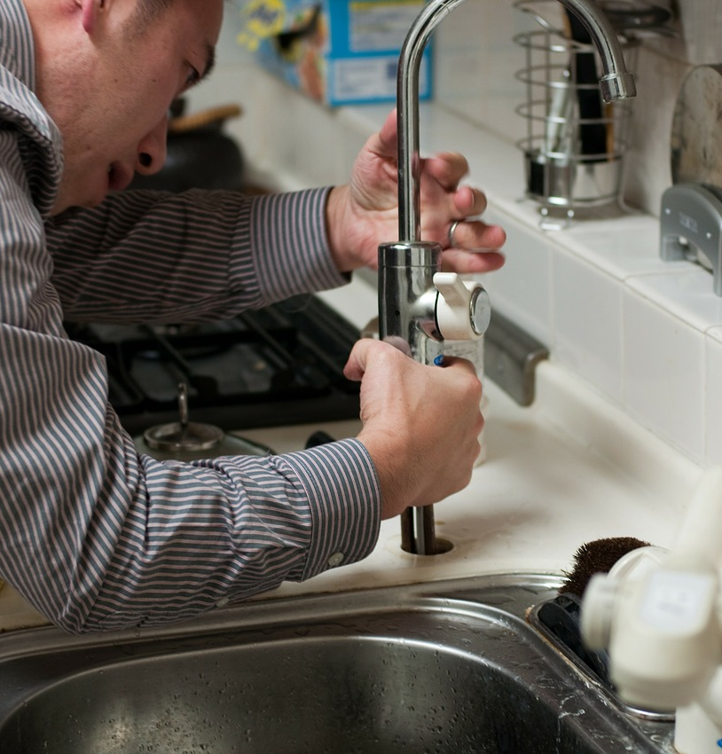
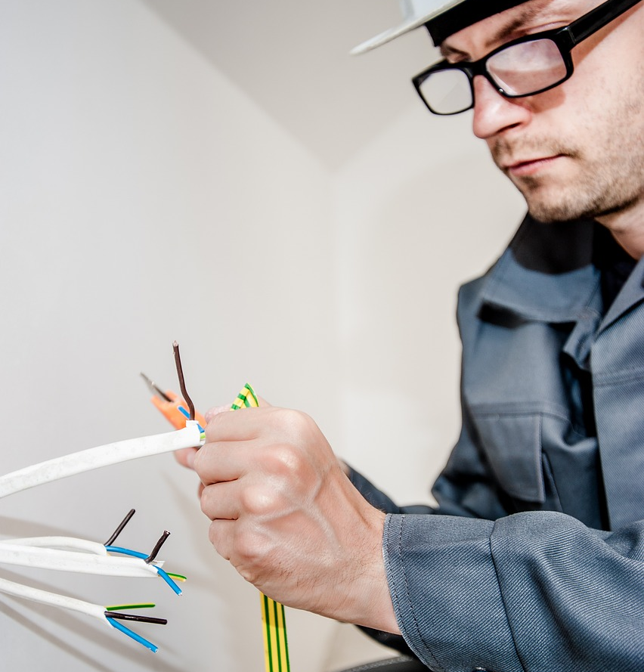

Slide 2

cooperative Building

Slide 3


Slide 4
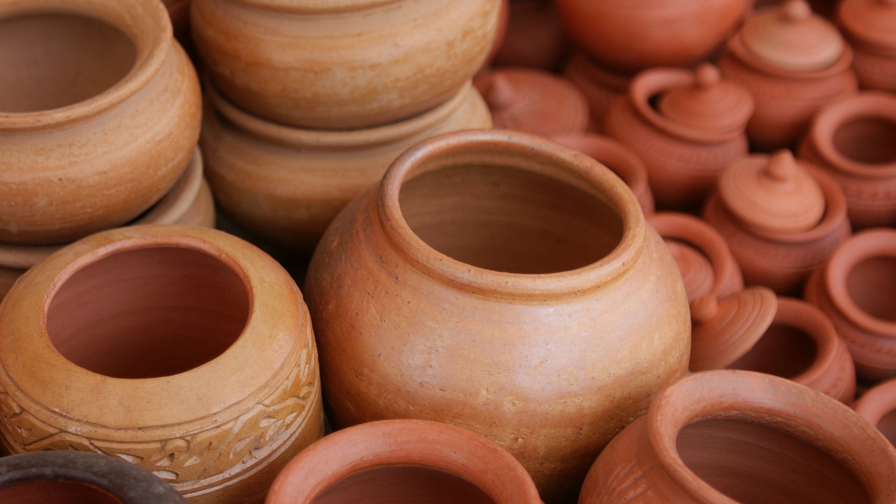

Slide 5


Slide 6


Slide 7


Slide 8


Slide 9
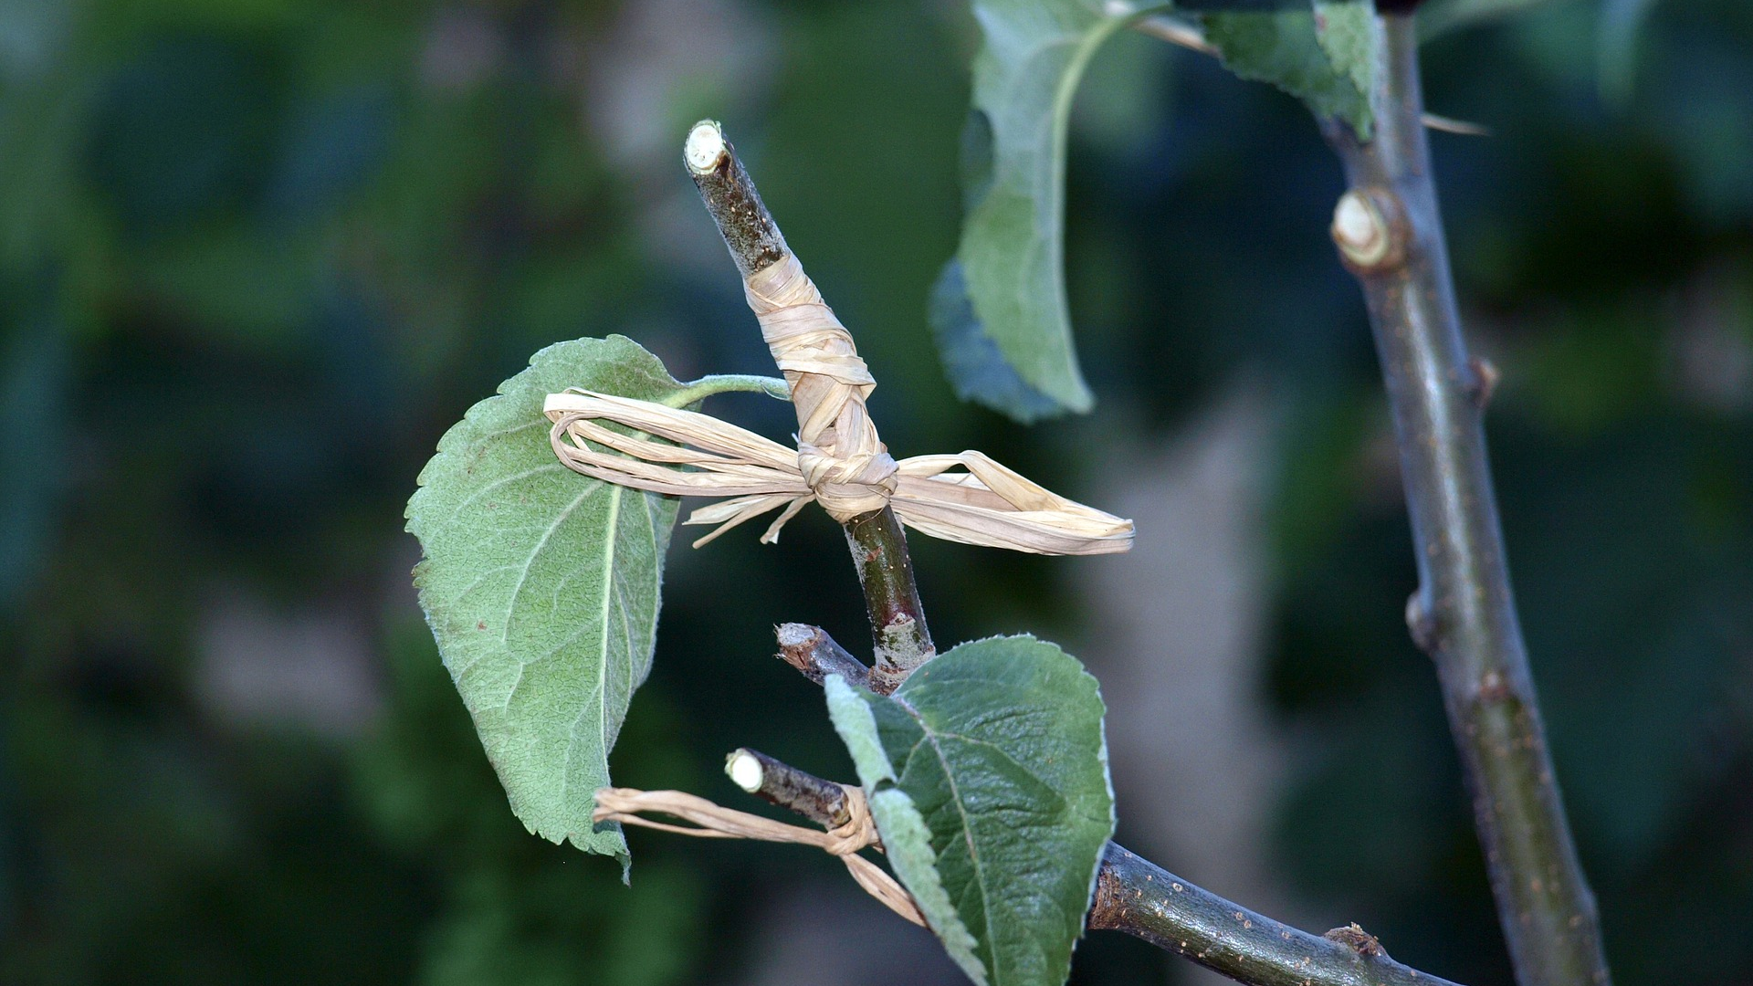

Slide 10


