Slide 1
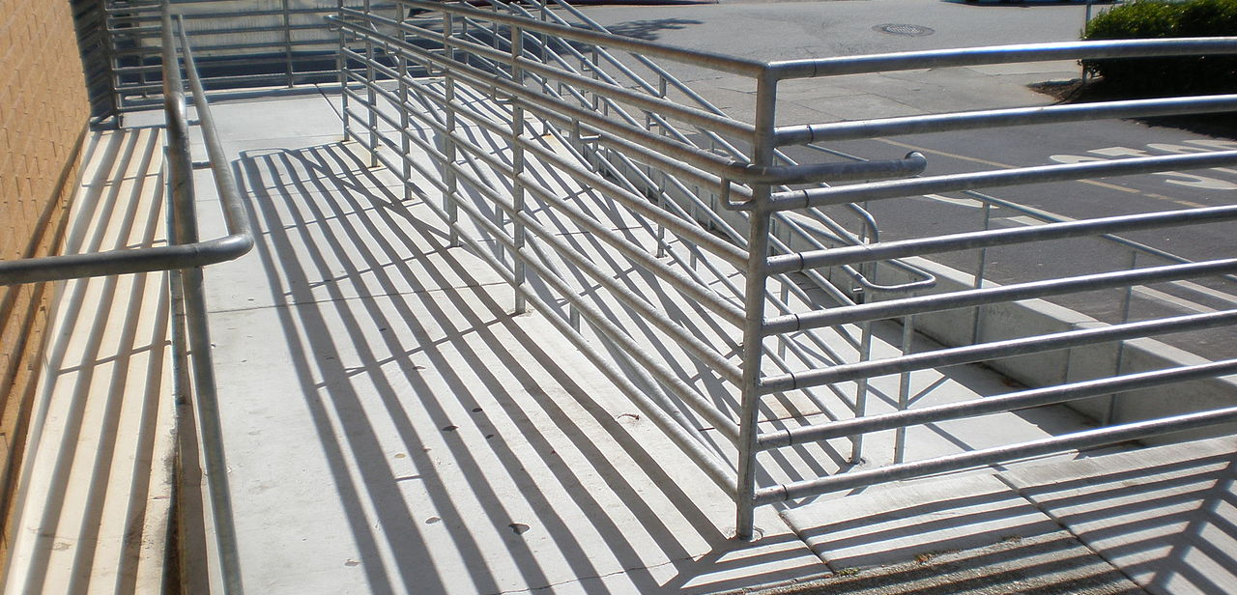
Accessable Building
BrokenSphere [CC BY-SA 3.0 (https://creativecommons.org/licenses/by-sa/3.0)]

Slide 2


Slide 3


Slide 4


Slide 5
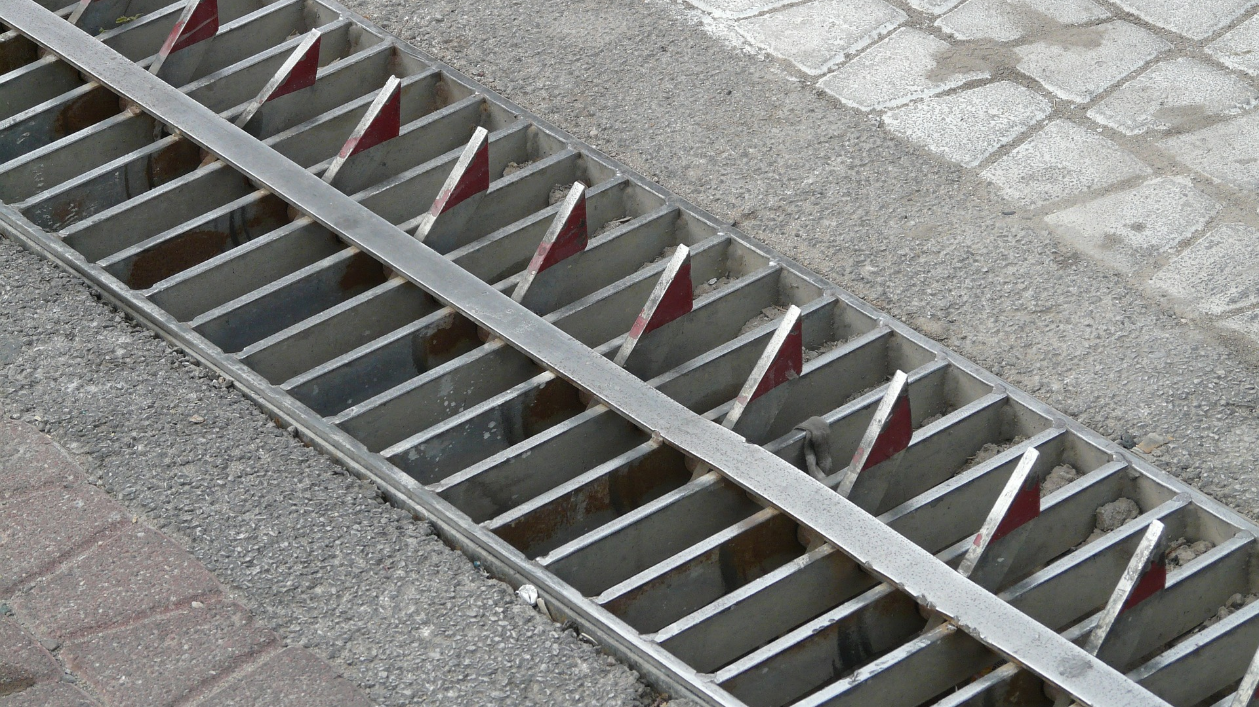

Slide 6
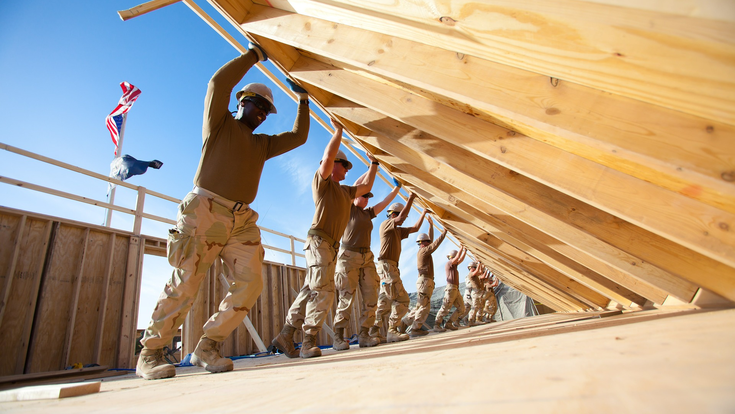

Slide 7
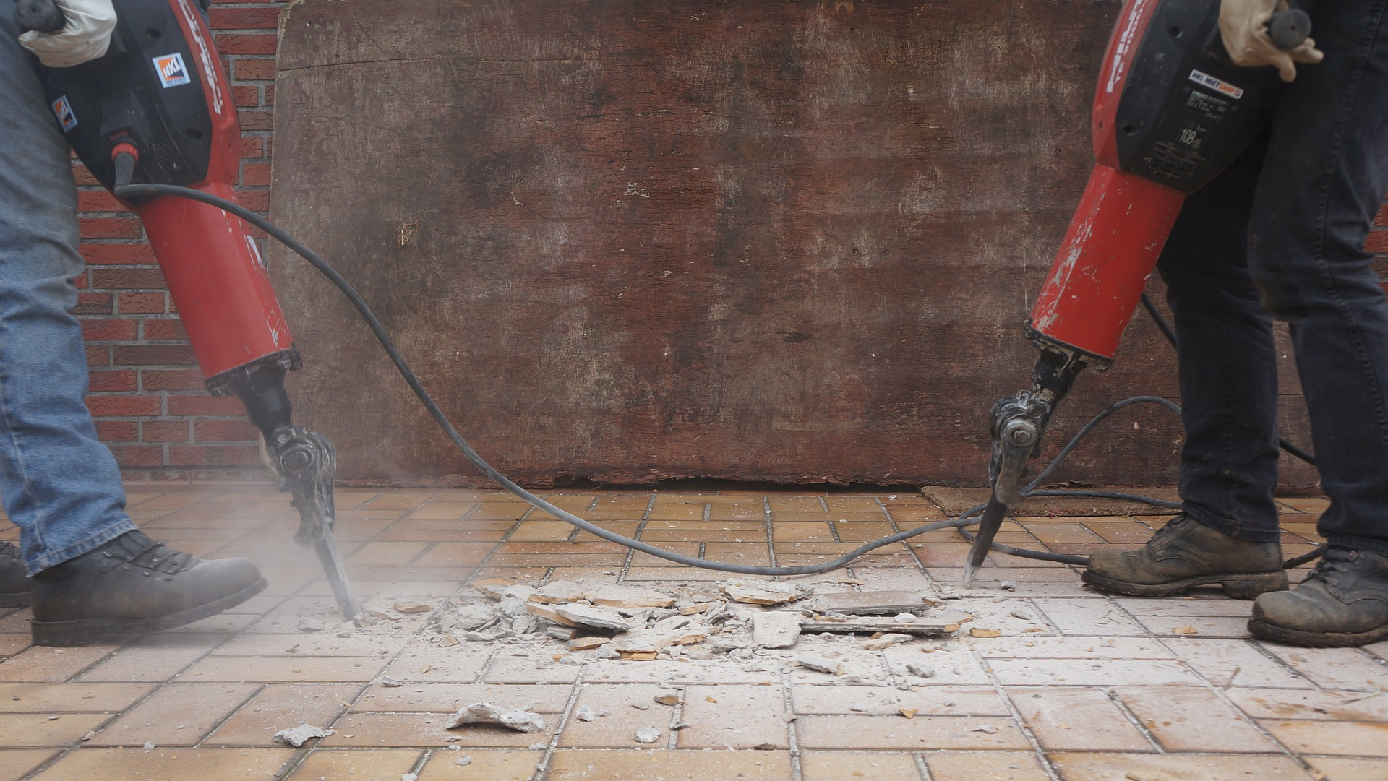

Slide 8


Slide 9


