Slide 1

Taking Time for Prayer

Slide 2
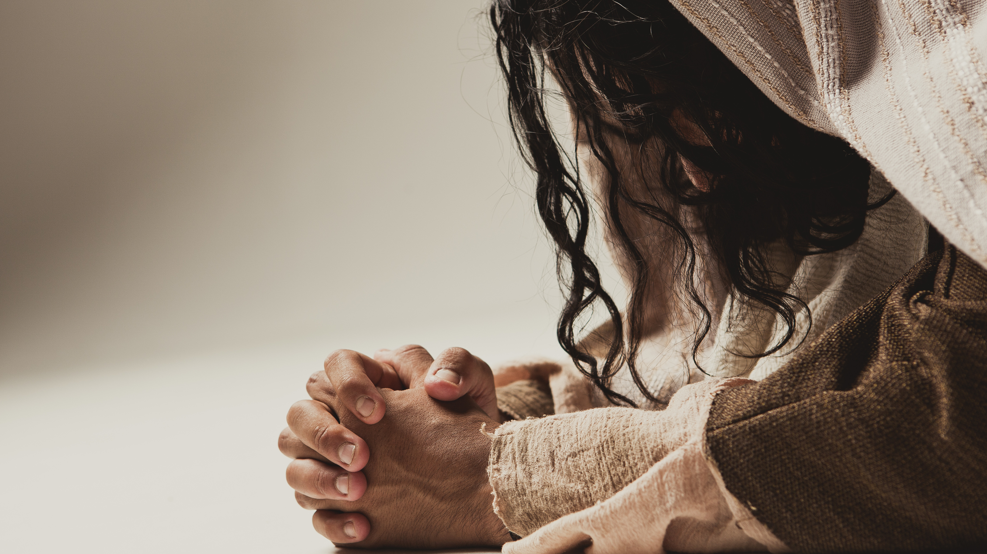

Slide 3
¹⁵ But the news about Him was spreading even farther, and large crowds were gathering to hear Him and to be healed of their sicknesses. ¹⁶ But Jesus Himself would often slip away to the wilderness and pray.
- Luke 5:15–16

Slide 4
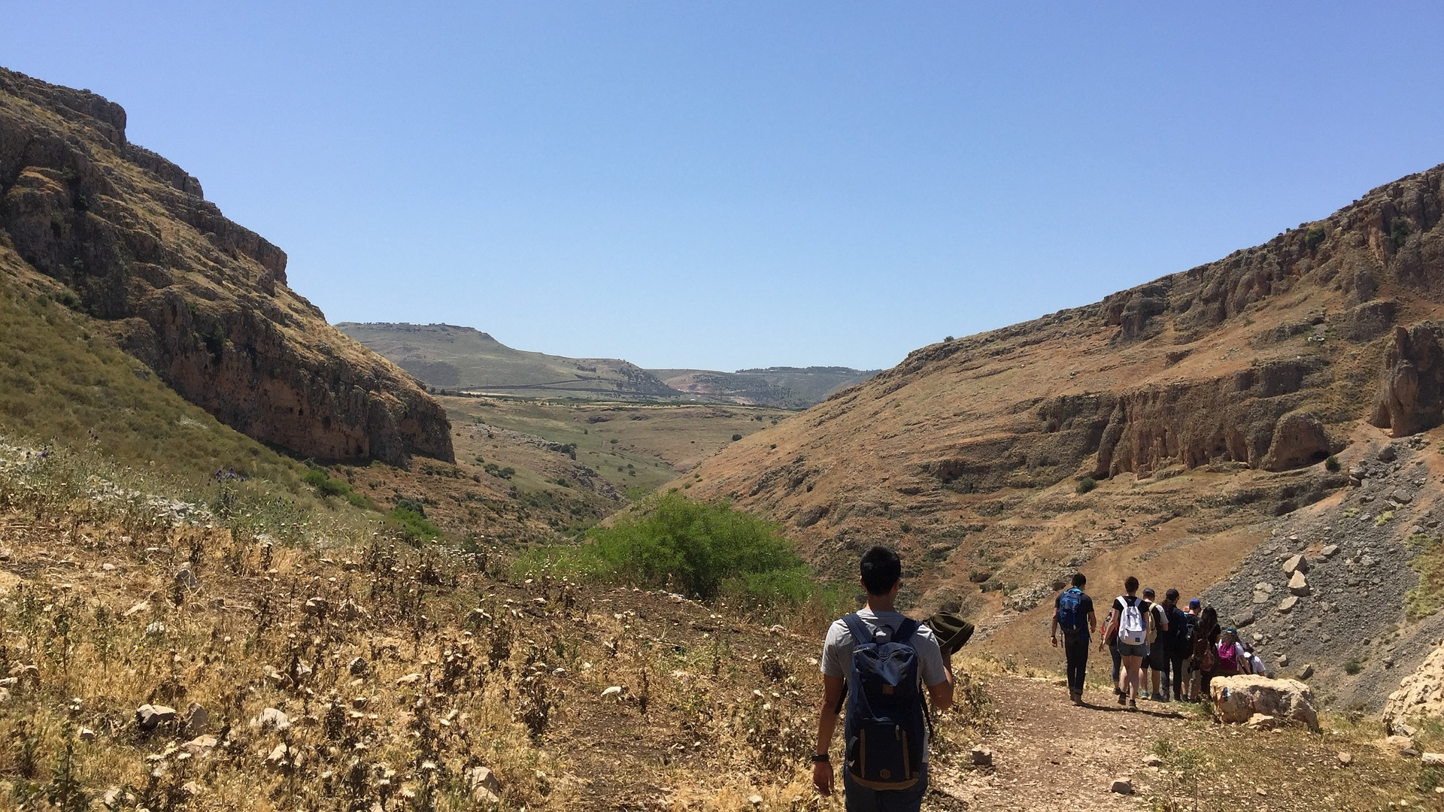

Slide 5
¹² It was at this time that He went off to the mountain to pray, and He spent the whole night in prayer to God. ¹³ And when day came, He called His disciples to Him and chose twelve of them, whom He also named as apostles:
- Luke 6:12–13

Slide 6
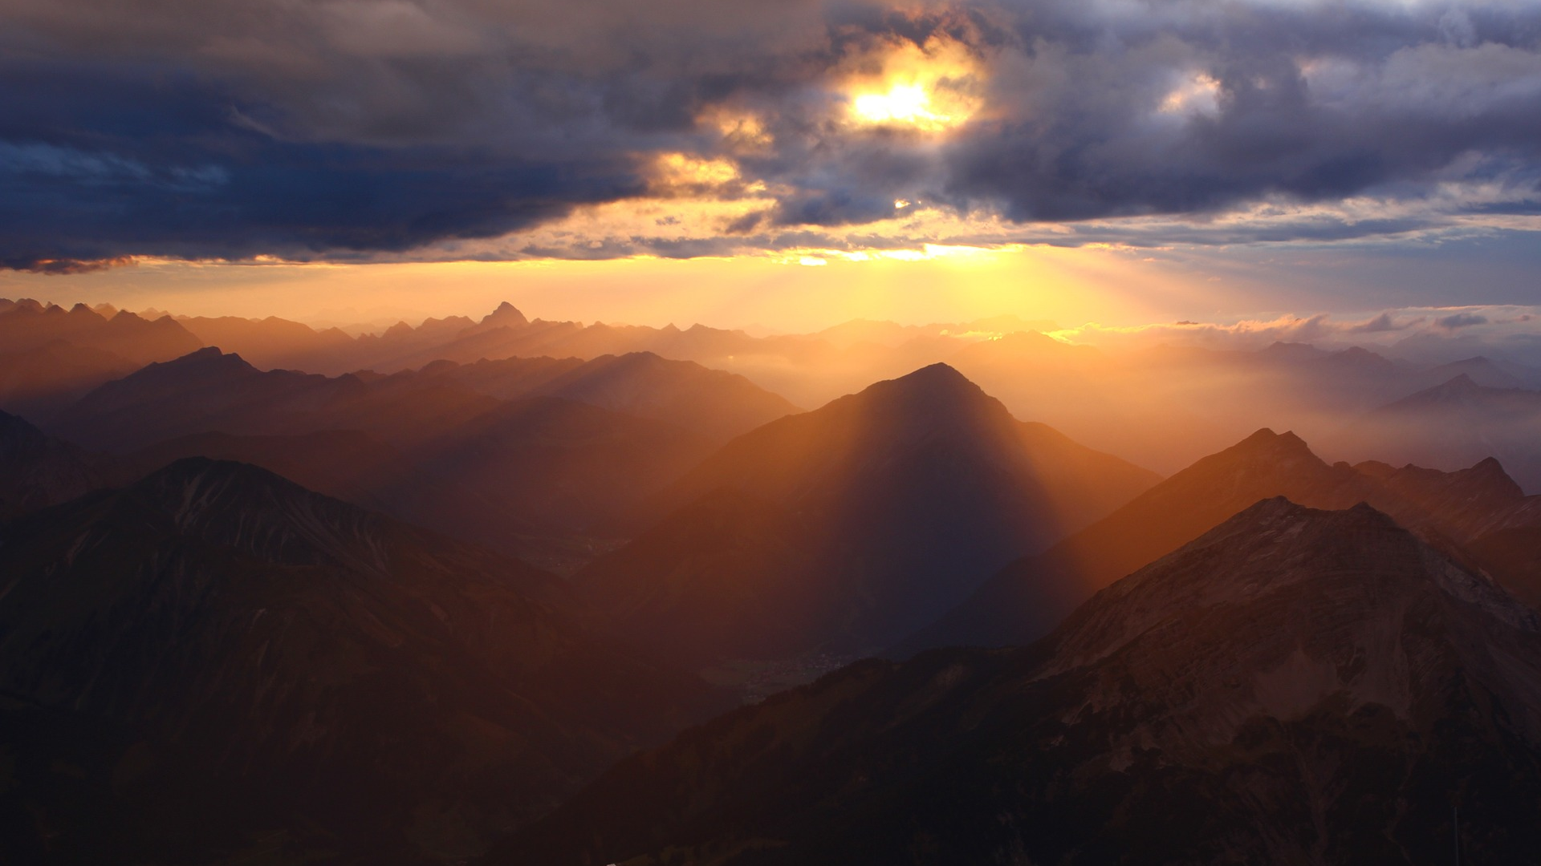

Slide 7
¹⁸ And it happened that while He was praying alone, the disciples were with Him, and He questioned them, saying, “Who do the people say that I am?”
- Luke 9:18

Slide 8


Slide 9
²⁸ Some eight days after these sayings, He took along Peter and John and James, and went up on the mountain to pray. ²⁹ And while He was praying, the appearance of His face became different, and His clothing became white and gleaming.
- Luke 9:28–29

Slide 10
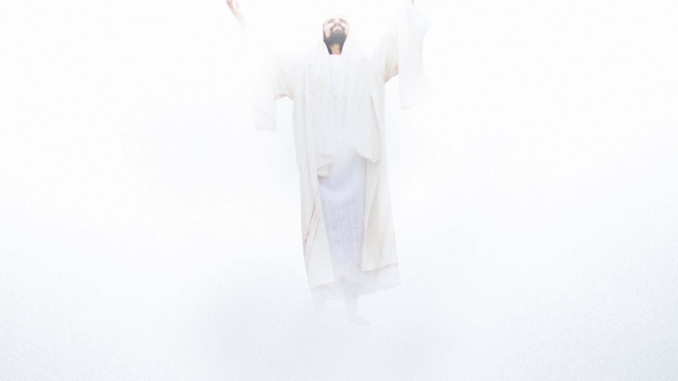

Slide 11
¹ It happened that while Jesus was praying in a certain place, after He had finished, one of His disciples said to Him, “Lord, teach us to pray just as John also taught his disciples.” ² And He said to them, “When you pray, say: ‘Father, hallowed be Your name. Your kingdom come. ³ ‘Give us each day our daily bread. ⁴ ‘And forgive us our sins, For we ourselves also forgive everyone who is indebted to us. And lead us not into temptation.’ ”
- Luke 11:1–4

Slide 12
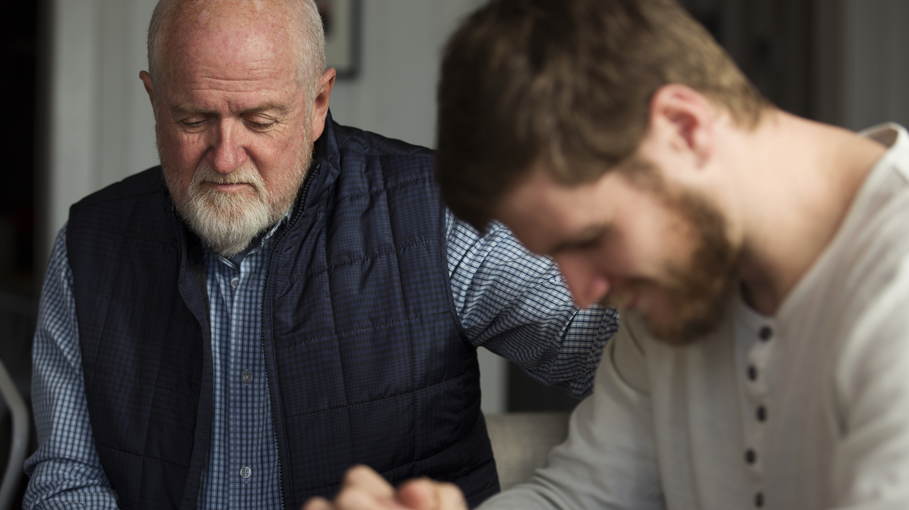

Slide 13
³⁹ And He came out and proceeded as was His custom to the Mount of Olives; and the disciples also followed Him. ⁴⁰ When He arrived at the place, He said to them, “Pray that you may not enter into temptation.” ⁴¹ And He withdrew from them about a stone’s throw, and He knelt down and began to pray, ⁴² saying, “Father, if You are willing, remove this cup from Me; yet not My will, but Yours be done.”
- Luke 22:39–42

Slide 14
