Slide 2
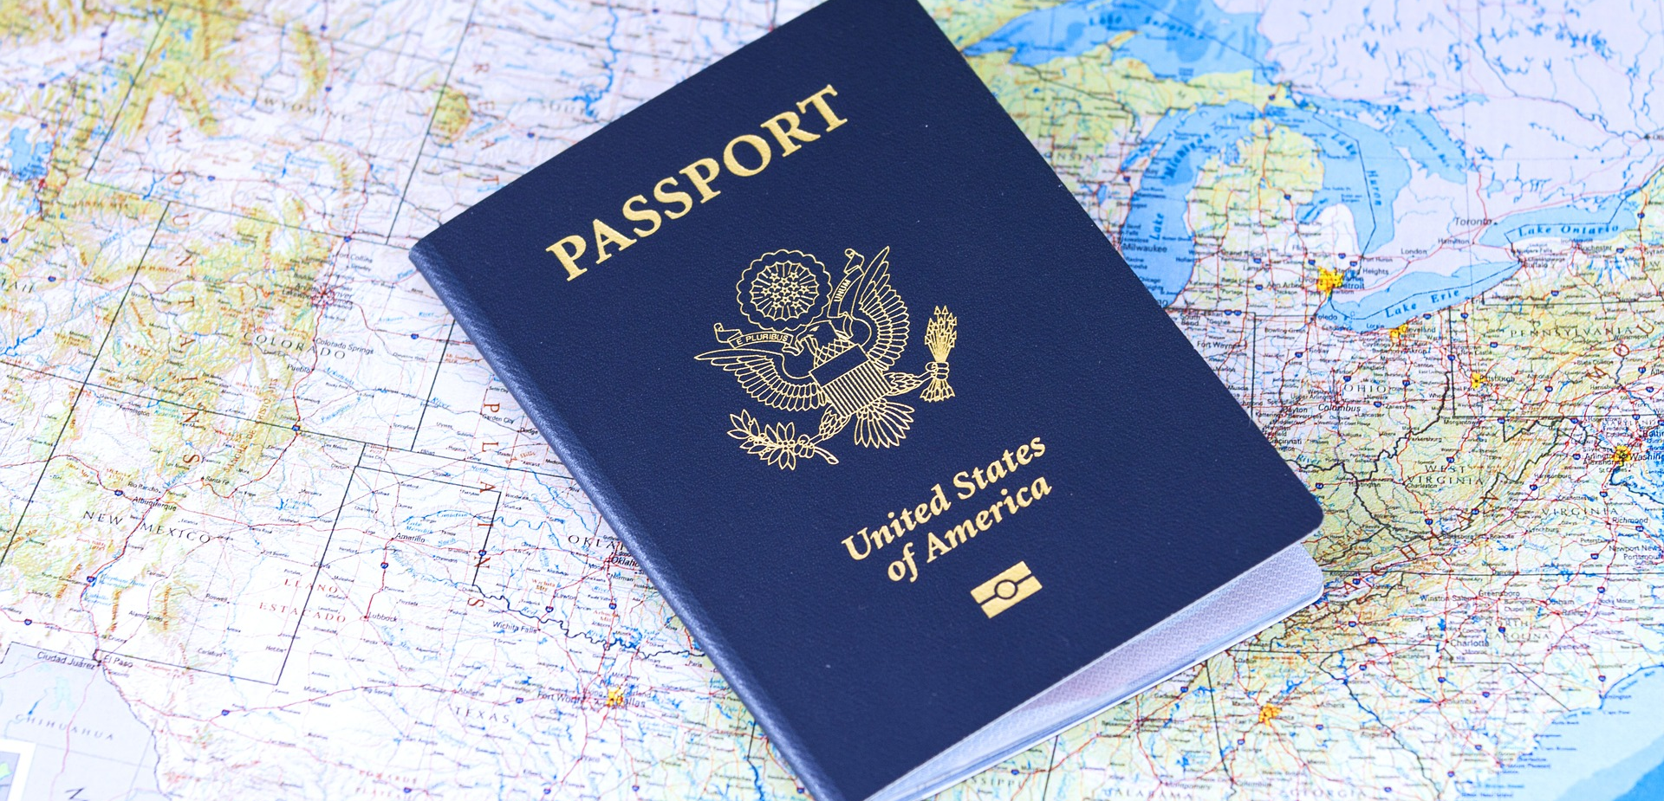
Saintly Citizens

Slide 3


Slide 4


Slide 5


Slide 6
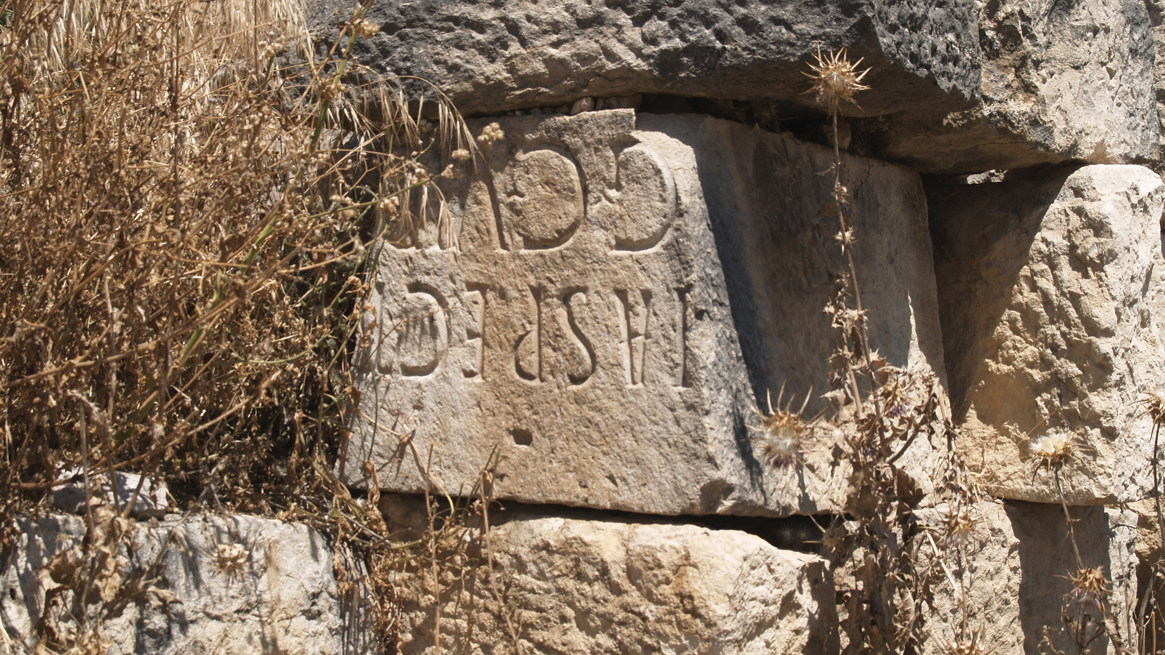
Photo courtesy: The Institute for the Study of the Ancient World, https://www.flickr.com/photos/isawnyu/5632838216

Slide 7
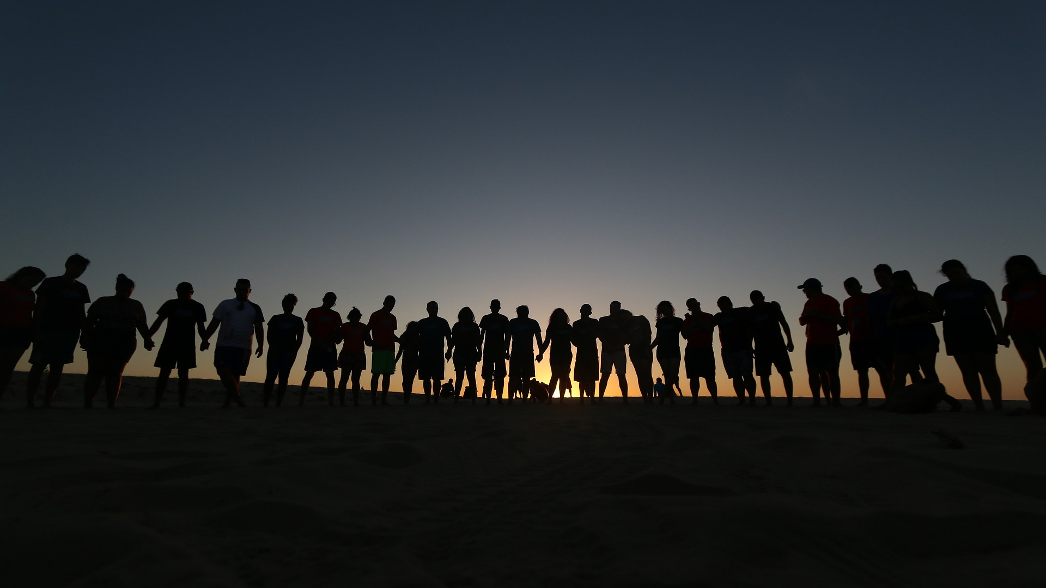

Slide 8


Slide 9


