Slide 1
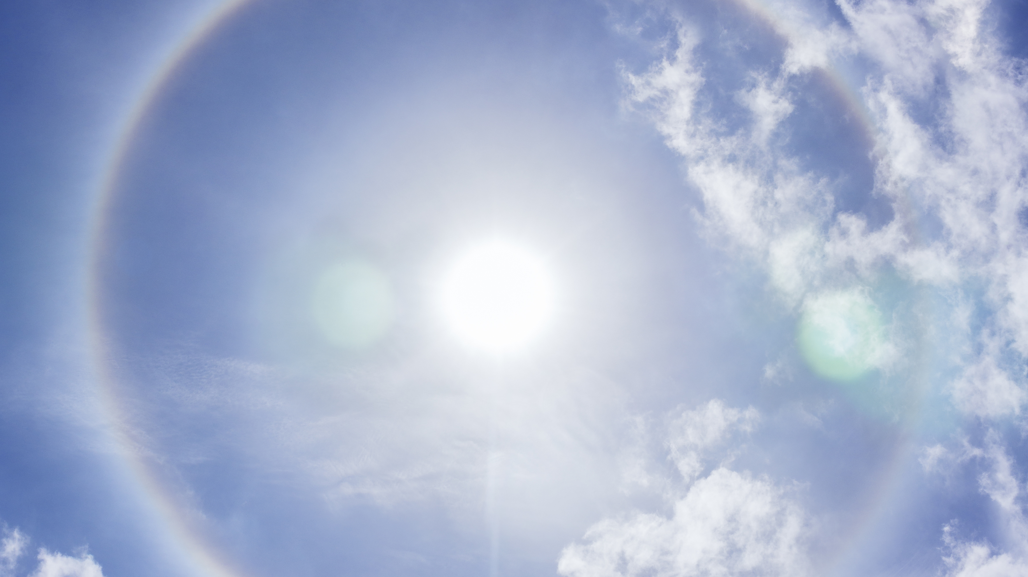
Prayers of Glory

Slide 2


Slide 3
⁴ “I glorified You on the earth, having accomplished the work which You have given Me to do. ⁵ “Now, Father, glorify Me together with Yourself, with the glory which I had with You before the world was.
- John 17:4–5

Slide 4


Slide 5
⁹ “I ask on their behalf; I do not ask on behalf of the world, but of those whom You have given Me; for they are Yours; ¹⁰ and all things that are Mine are Yours, and Yours are Mine; and I have been glorified in them. ¹¹ “I am no longer in the world; and yet they themselves are in the world, and I come to You. Holy Father, keep them in Your name, the name which You have given Me, that they may be one even as We are.
- John 17:9–11

Slide 6
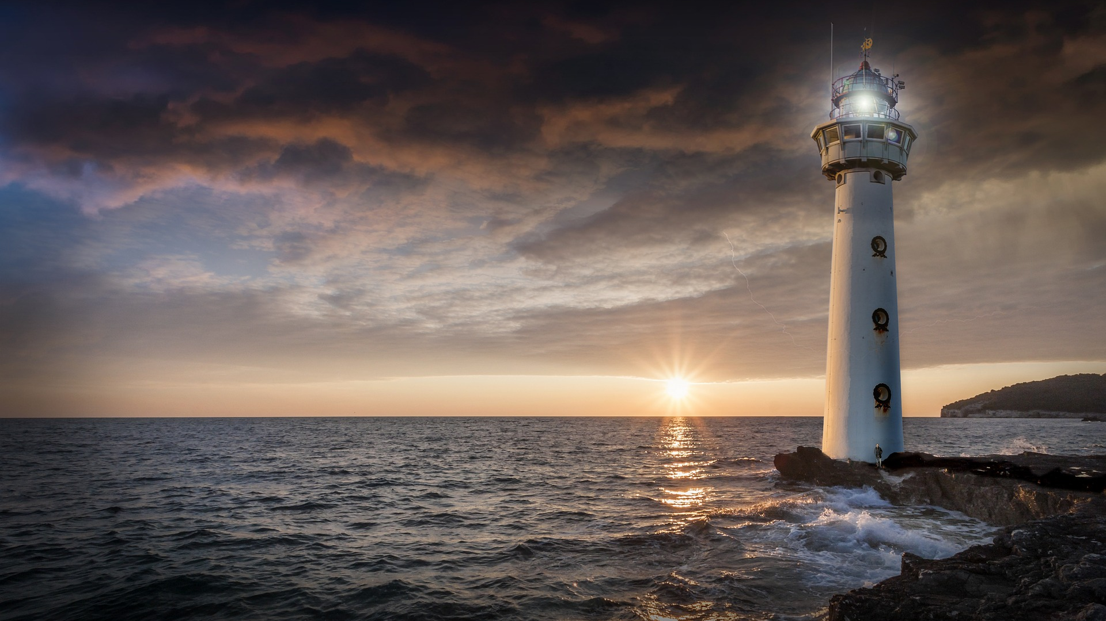

Slide 7
¹⁴ “I have given them Your word; and the world has hated them, because they are not of the world, even as I am not of the world. ¹⁵ “I do not ask You to take them out of the world, but to keep them from the evil one. ¹⁶ “They are not of the world, even as I am not of the world. ¹⁷ “Sanctify them in the truth; Your word is truth. ¹⁸ “As You sent Me into the world, I also have sent them into the world.
- John 17:14–18

Slide 8


Slide 9
²⁵ “O righteous Father, although the world has not known You, yet I have known You; and these have known that You sent Me; ²⁶ and I have made Your name known to them, and will make it known, so that the love with which You loved Me may be in them, and I in them.”
- John 17:25–26

Slide 10


Slide 11


