Slide 1
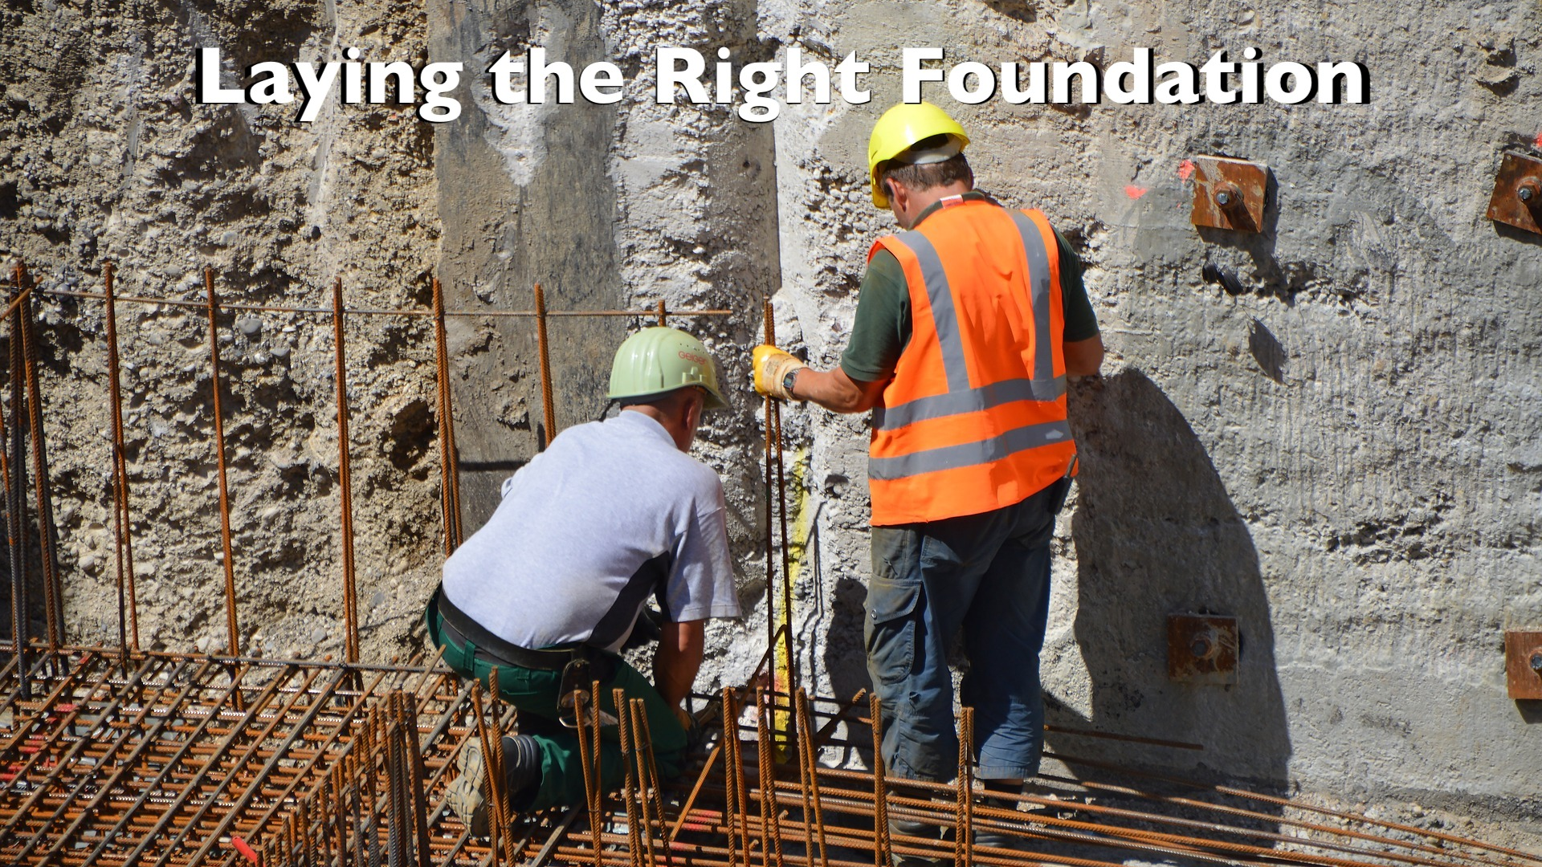

Slide 3
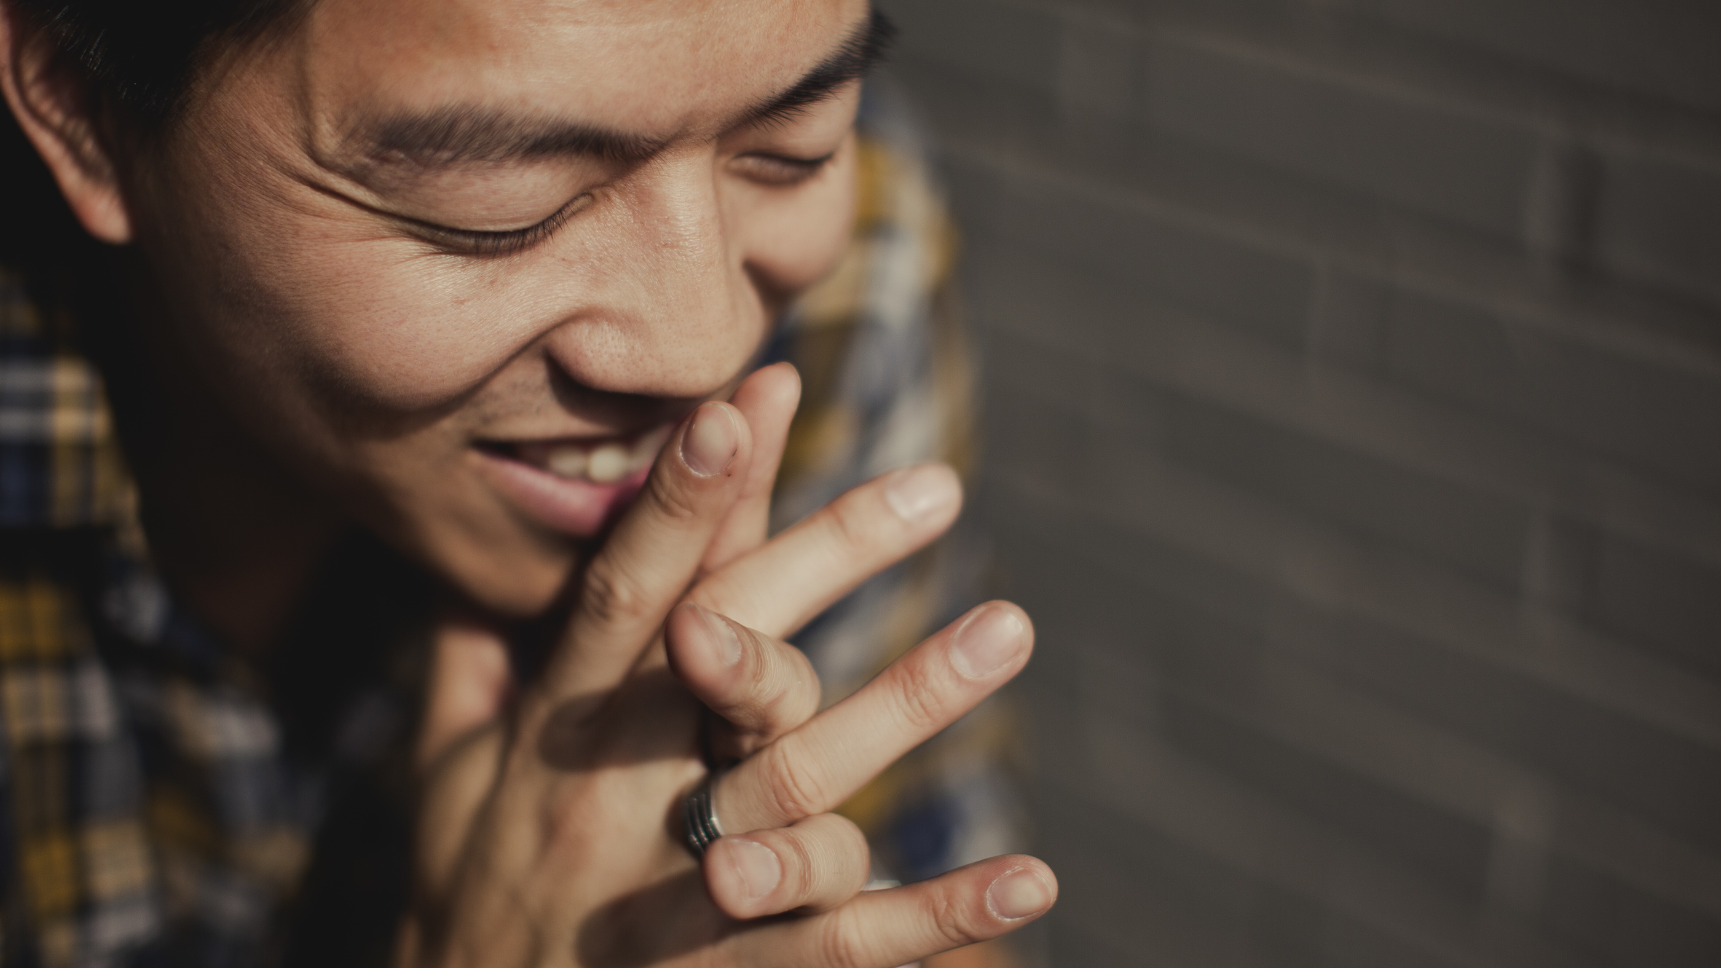

Slide 4
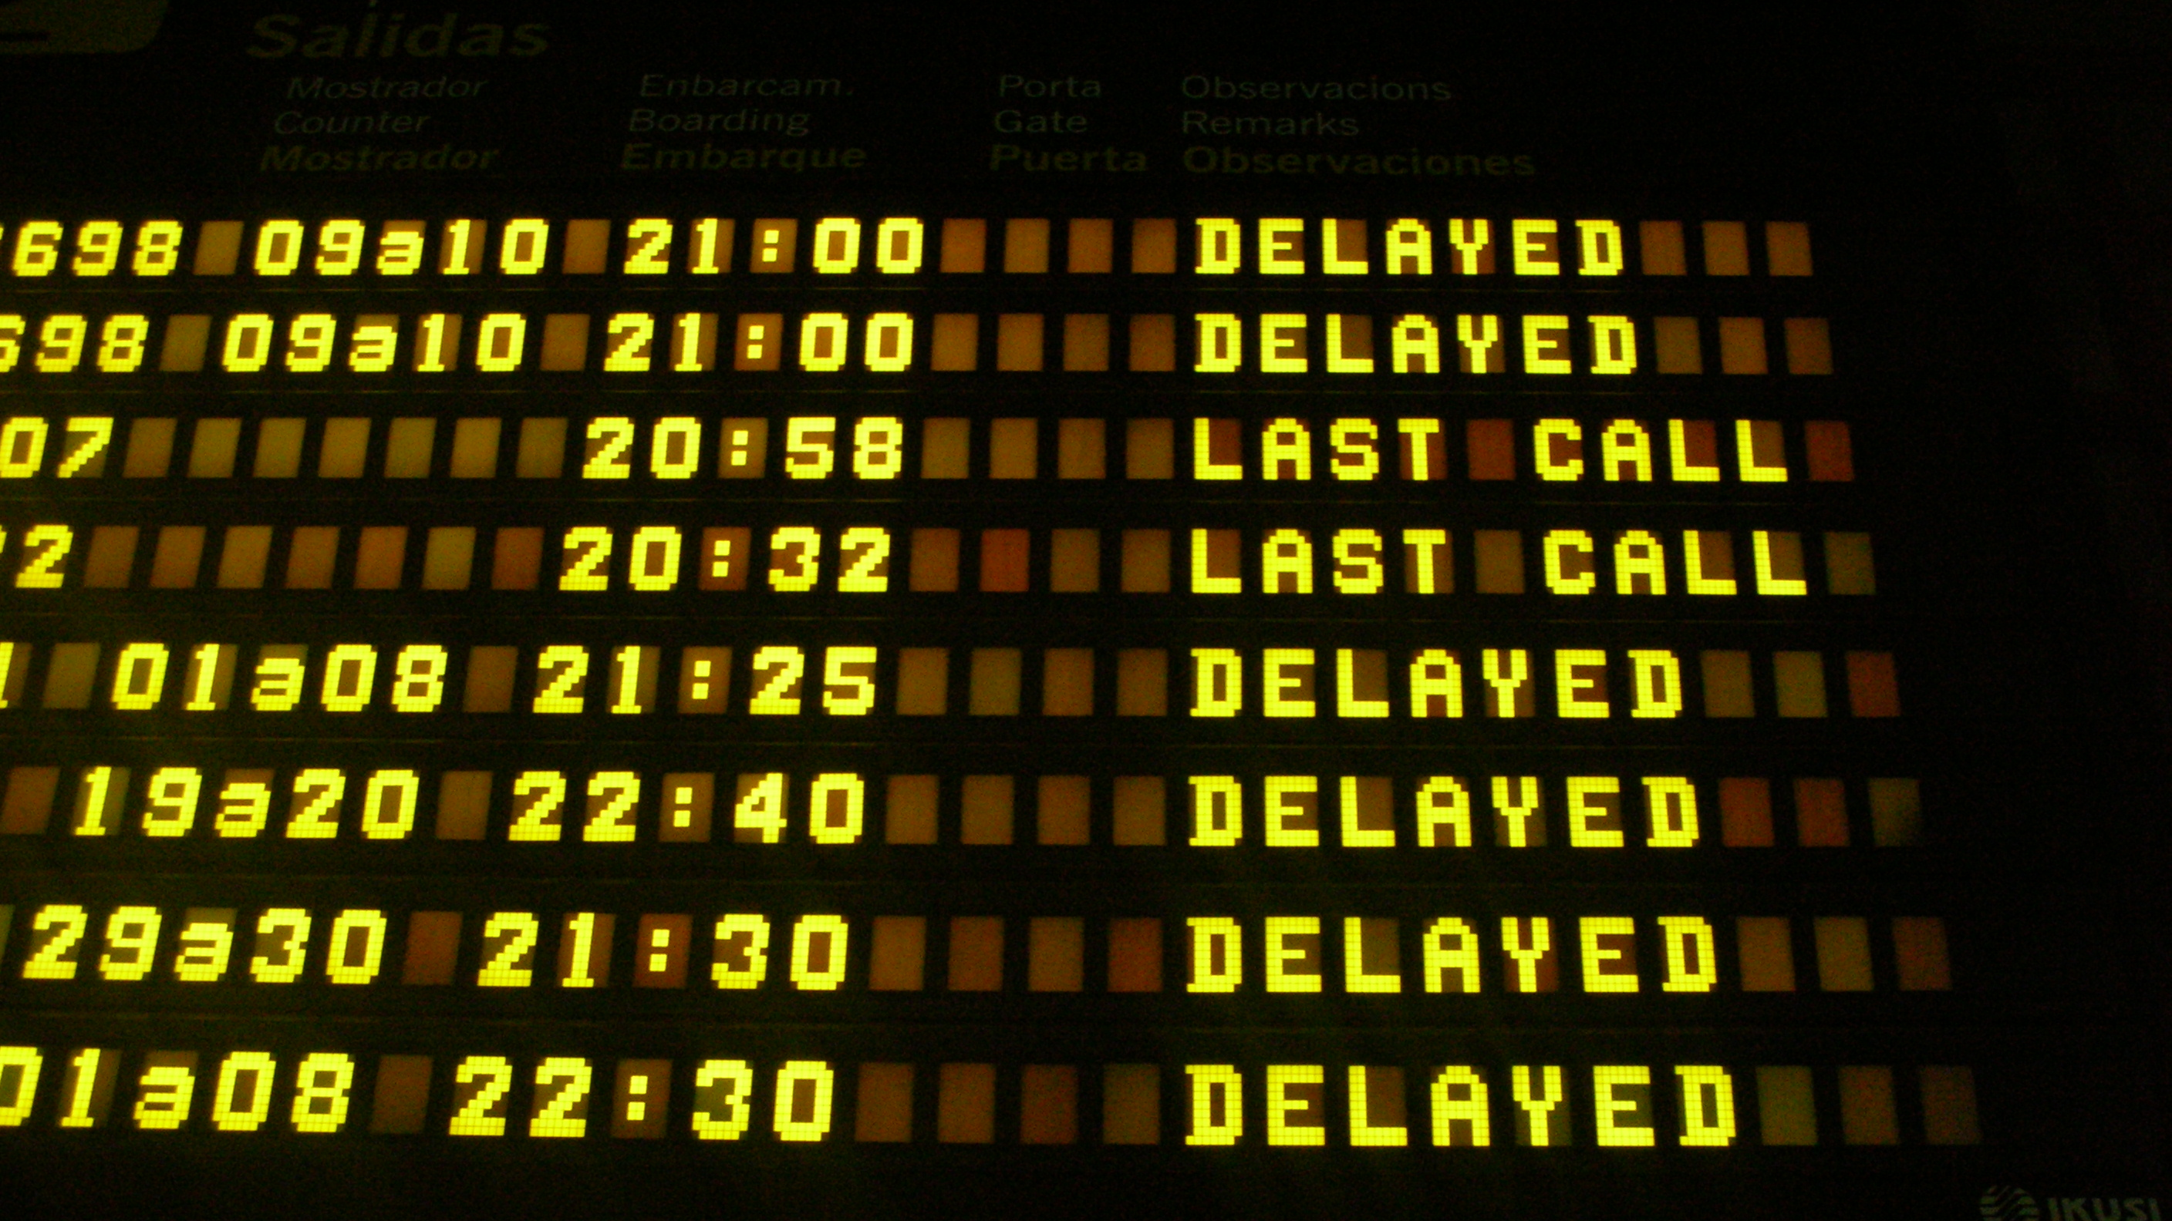
Photo courtesy: https://www.flickr.com/photos/jjvaca/728072059

Slide 5
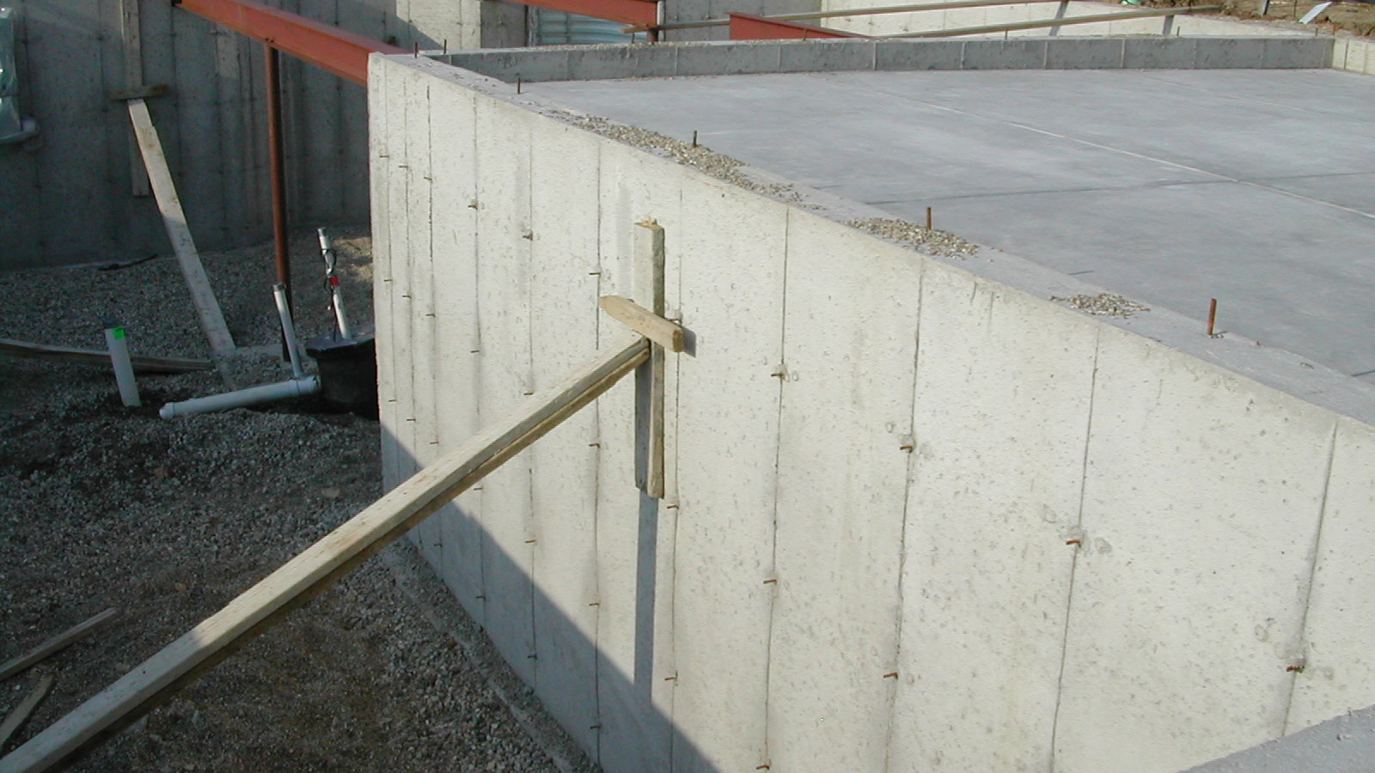
Photo courtesy: https://www.flickr.com/photos/armchairbuilder/6198714006
Notes:
Establish (strengthen) them in the Spirit - wants to make sure they are prepared for the task ahead of them
By being with them he hoped to further the fruits of the gospel and edify the church

Slide 6
¹⁴ I am under obligation both to Greeks and to barbarians, both to the wise and to the foolish. ¹⁵ So, for my part, I am eager to preach the gospel to you also who are in Rome.
- Romans 1:14–15

Slide 7
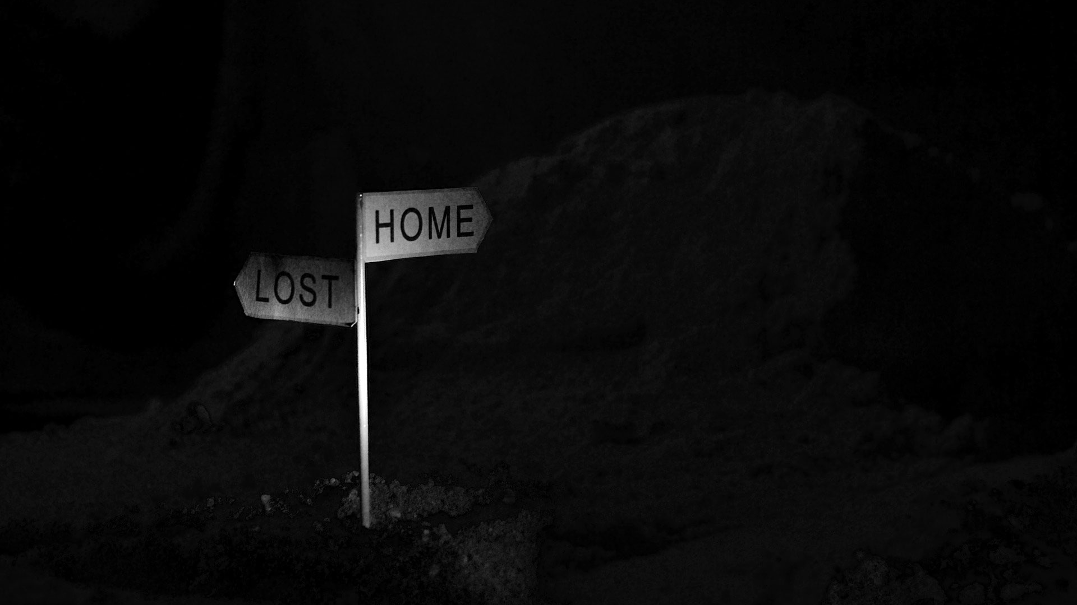
Notes:
Obligated to all men - all deserve a chance, all are in need, not a sense of duty, but a desire born out of the need

Slide 8
¹⁶ For I am not ashamed of the gospel, for it is the power of God for salvation to everyone who believes, to the Jew first and also to the Greek.
- Romans 1:16

Slide 9

Notes:
There is no perceived loss of status among men based upon his belief in Jesus
That shame is based upon inaction - Mark 8:38

Slide 10
¹⁷ For in it the righteousness of God is revealed from faith to faith; as it is written, “But the righteous man shall live by faith.”
- Romans 1:17

Slide 11
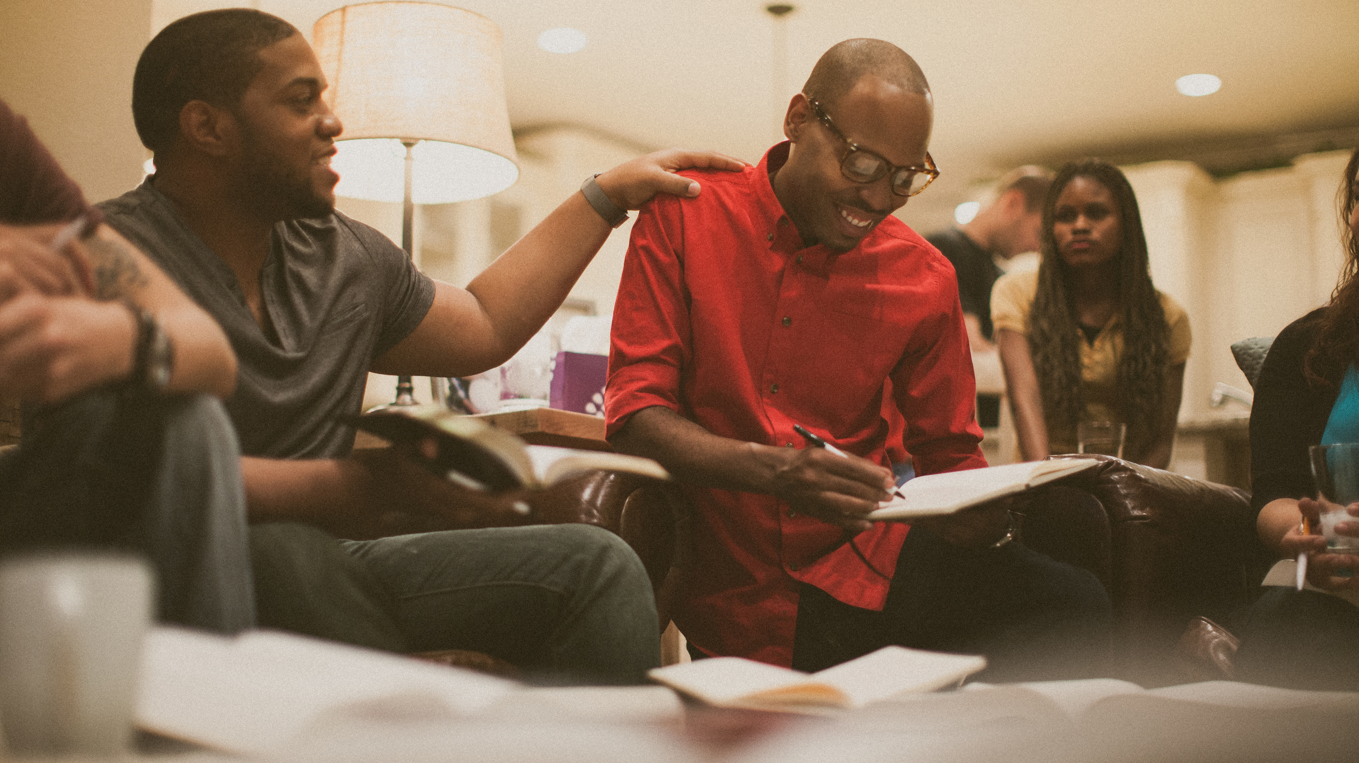
Notes:
Our lives are defined by our faith, we do not walk blindly, but based upon the evidence we live differently - live by faith

Slide 12
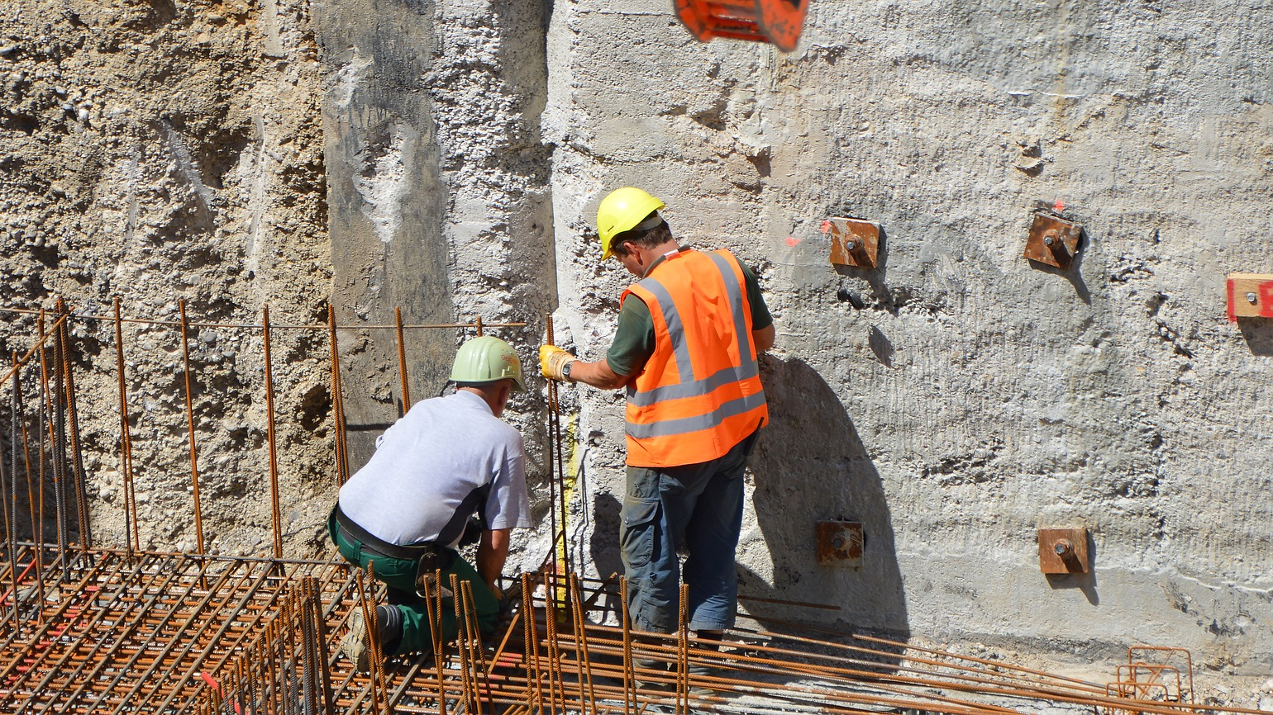
Reinforce
Apply
Share

