Slide 1
How Does Grace Work?

Slide 2
Unmerited favor of God

Slide 3
⁴⁰ The Child continued to grow and become strong, increasing in wisdom; and the grace of God was upon Him. - Luke 2:40
¹⁴ And the Word became flesh, and dwelt among us, and we saw His glory, glory as of the only begotten from the Father, full of grace and truth. - John 1:14

Slide 5
Χάρις - charis
It is the base for our English word charisma.
Favorable, or favored, or the idea of giving favor to someone or something.

Slide 7
¹⁸ but grow in the grace and knowledge of our Lord and Savior Jesus Christ. To Him be the glory, both now and to the day of eternity. Amen. - 2 Peter 3:18

Slide 9
¹¹ For the grace of God has appeared, bringing salvation to all men, ¹² instructing us to deny ungodliness and worldly desires and to live sensibly, righteously and godly in the present age… - Titus 2:11–12

Slide 11
¹⁵ But the free gift is not like the transgression. For if by the transgression of the one the many died, much more did the grace of God and the gift by the grace of the one Man, Jesus Christ, abound to the many. - Romans 5:15

Slide 12
⁸ For by grace you have been saved through faith; and that not of yourselves, it is the gift of God; ⁹ not as a result of works, so that no one may boast. - Ephesians 2:8–9

Slide 14
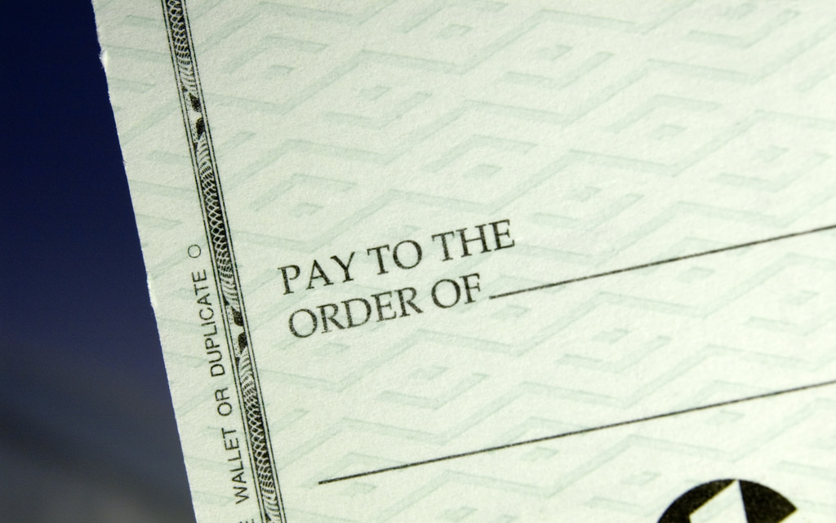
https://www.flickr.com/photos/dslrninja/446737429

Slide 15
Be humble (accept the gift) Be godly (honor the gift)
Be gracious (use the gift)

