Slide 1

How Does Faith Work?

Slide 3


Slide 4
¹ Now faith is the assurance of things hoped for, the conviction of things not seen.
- Hebrews 11:1

Slide 5
Assurance (substance) - based upon something that can be substantiated or proven
Conviction (evidence) - presenting proof of the truth or validity of something

Slide 6
Things hoped for (expected) - looking forward with confidence something will come to pass
Things not seen - not perceived/looked upon with our own eyes

Slide 7
By Takver from Australia [CC BY-SA 2.0 (https://creativecommons.org/licenses/by-sa/2.0)], via Wikimedia Commons

Slide 8
⁶ And without faith it is impossible to please Him, for he who comes to God must believe that He is and that He is a rewarder of those who seek Him.
- Hebrews 11:6

Slide 9
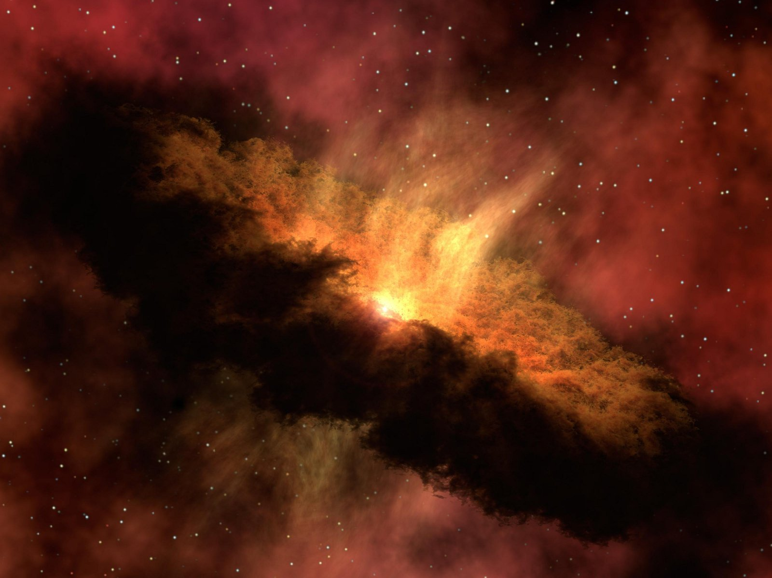

Slide 10


Slide 11
³⁶ For you have need of endurance, so that when you have done the will of God, you may receive what was promised. ³⁷ For yet in a very little while, He who is coming will come, and will not delay.

Slide 12
³⁸ But My righteous one shall live by faith; And if he shrinks back, My soul has no pleasure in him. ³⁹ But we are not of those who shrink back to destruction, but of those who have faith to the preserving of the soul.
- Hebrews 10:36–39

Slide 14
²⁸ For we maintain that a man is justified by faith apart from works of the Law.
- Romans 3:28
¹ Therefore, having been justified by faith, we have peace with God through our Lord Jesus Christ…
- Romans 5:1

Slide 15
¹⁷ Even so faith, if it has no works, is dead, being by itself.
- James 2:17
²⁴ You see that a man is justified by works and not by faith alone.
- James 2:24

Slide 16
¹⁷ So faith comes from hearing, and hearing by the word of Christ.
- Romans 10:17
¹² …having been buried with Him in baptism, in which you were also raised up with Him through faith in the working of God, who raised Him from the dead.
- Colossians 2:12

Slide 17
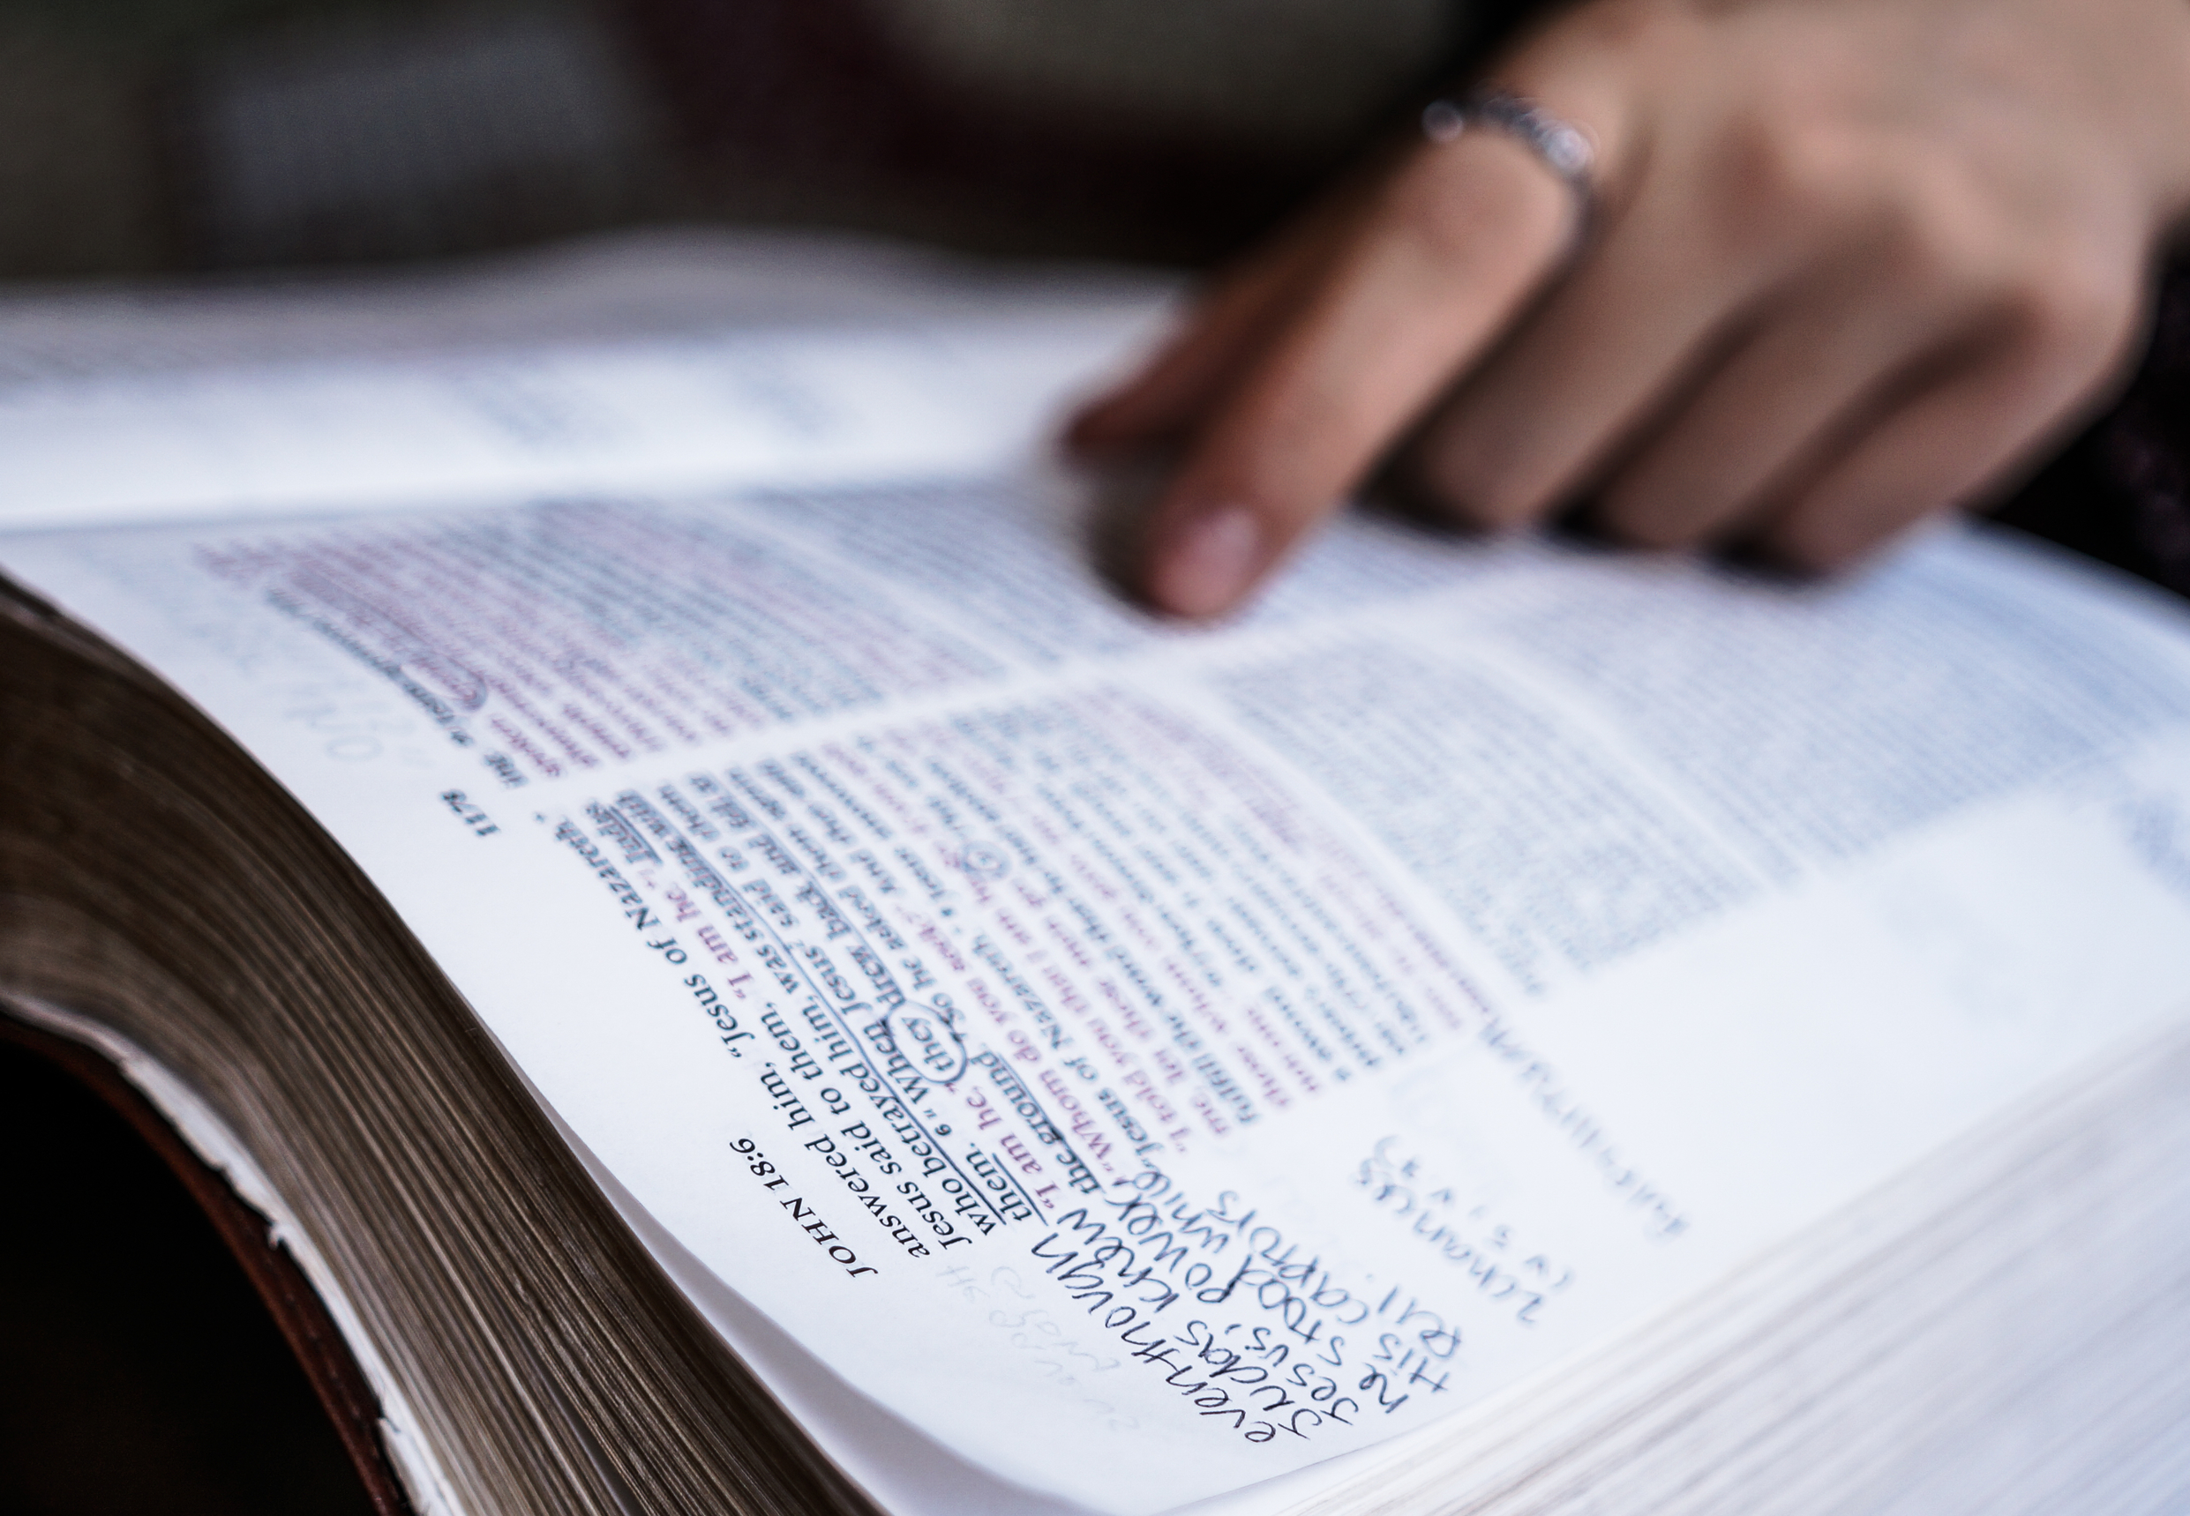

Slide 18


Slide 19


Slide 20

Add 20 minutes a day to your Bible reading
Put your faith into action:
Help others see the glory of the gospel

