Slide 1
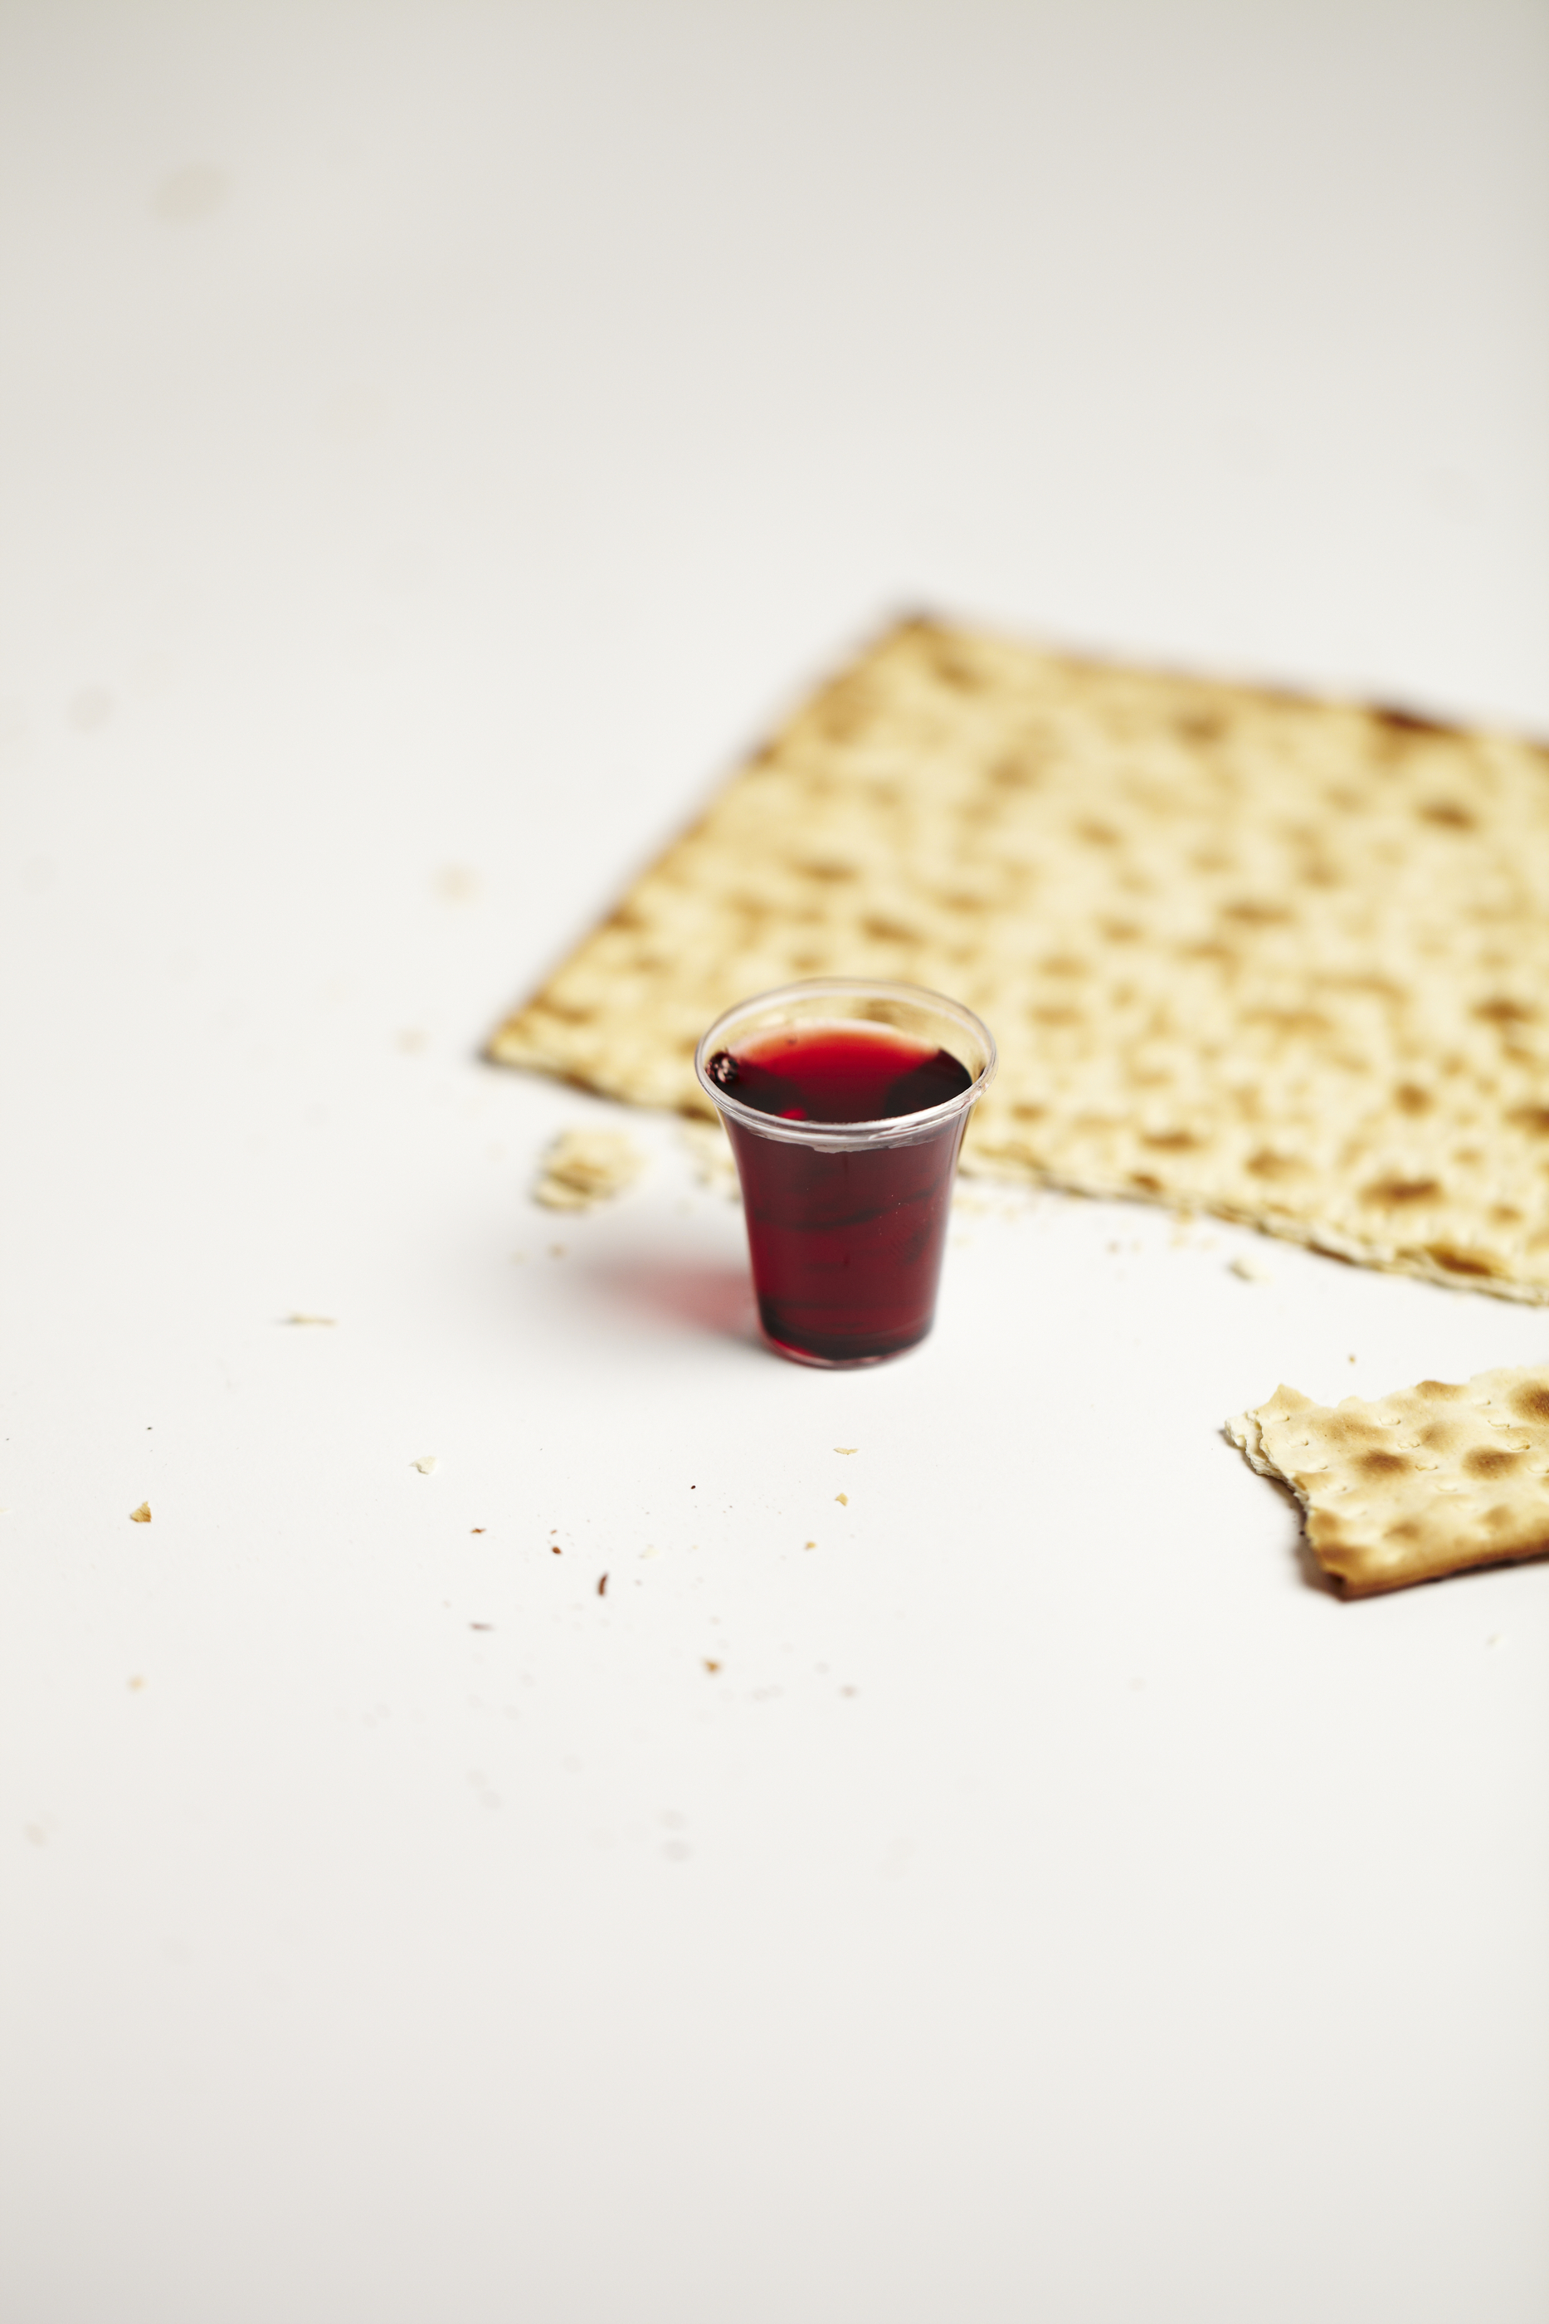
Communing in Worship

Slide 3
And when He had taken some bread and given thanks, He broke it and gave it to them, saying, "This is My body which is given for you; do this in remembrance of Me."
Luke 22:19

Slide 5
And in the same way He took the cup after they had eaten, saying, "This cup which is poured out for you is the new covenant in My blood."
Luke 22:19

Slide 7
For as often as you eat this bread and drink the cup, you proclaim the Lord's death until He comes.
1 Corinthians 11:26

Slide 9
Therefore whoever eats the bread or drinks the cup of the Lord in an unworthy manner, shall be guilty of the body and the blood of the Lord.
1 Corinthians 11:27

Slide 11
Focus
Appreciation
Love

